Slide 1


CONGRESS OF THE FEDERATION INTERNATIONAL OF POWERCHAIR FOOTBALL 2022
DATE: November 5, 2022
Microsoft Teams
12:00 PM – 2:00 PM UK Time
Welcome
You will be muted, but don’t worry
We will get started at 12pm

Slide 2



TEAMS DIRECTIONS
Mute Microphone
Raise your ‘hand’ to ask a question
Type ‘QUESTION’ in the chat box
Up to you if you want your camera on
We will be recording the session

Slide 3
TEAMS DIRECTIONS
    REMEMBER TO SPEAK SLOWLY!
    This will help everyone to be able to understand you and some of our members will need time for translations.

Slide 4
BARB PEACOCK - SECRETARY GENERAL
Roll Call
  All attendees will be asked to identify themselves and attendance will be noted.
NOTE: This meeting will be recorded via Teams for future reference

Slide 5
TODAY’S AGENDA
Introduction by Ricky Stevenson, President
Reports:
  Zone reports:
    Americas Zone – Alberto Martinez
    Asia/Oceania Zone – Tristram Peters
    European Zone - Donal Byrne

Slide 6
TODAY’S AGENDA (continued)
Reports (continued):
  Barb Peacock, Secretary General:
    Status of the Secretariat
    Review of Voting Procedures/Voting Rights
    2021 Annual Report
      2021 Financial Report included
  Ricky Stevenson, President:
    2021/22 Reflections
    Partner Updates

Slide 7
TODAY’S AGENDA (continued)
Reports (continued):
  FIPFA Powerchair Football World Cup 2023 Update by Andy Harper, Chair of LOC
  Sport Department Update by Sophie Bevan, Director of Sport
  Constitution Update by Ricky Stevenson, President
    Background Information
    Proposed Draft Constitution
    Vote from Membership Required

Slide 8
TODAY’S AGENDA (continued)
Reports (continued):
  Election for President:
    Four Year Term ending in 2026
    Nominees:
      Ricky Stevenson, England
        Comments from Ricky
      Sebastian Tisera, Argentina
        Comments from Sebastian
  Voting and results
  Conclusion by Ricky Stevenson, President

Slide 9
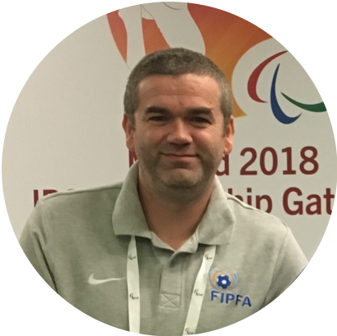

Introduction
Notes:
Introduction and welcome

Slide 10
REPORTS

Slide 11
Zone Reports by Zone Representatives
Zone Reports:
Americas – Alberto Martinez
Asia-Pacific-Oceania – Tristram Peters
Europe – Donal Byrne

Slide 12

Alberto Martinez - AMERICAS ZONE

Slide 13

Back to the court
Return to national competitions

Slide 14

Organization
US Soccer Federation recognizes USPSA
Power Soccer National Team to be a member of US Soccer Extended National Teams

Slide 15

Competitions
Friendly Tournament:
The Copa Libertadores (Clubs) and the Copa Sudamericana (National Teams) will be in Buenos Aires with the participation of teams from Argentina, Brazil and Uruguay.
November 16 & 17 November 18

Slide 16
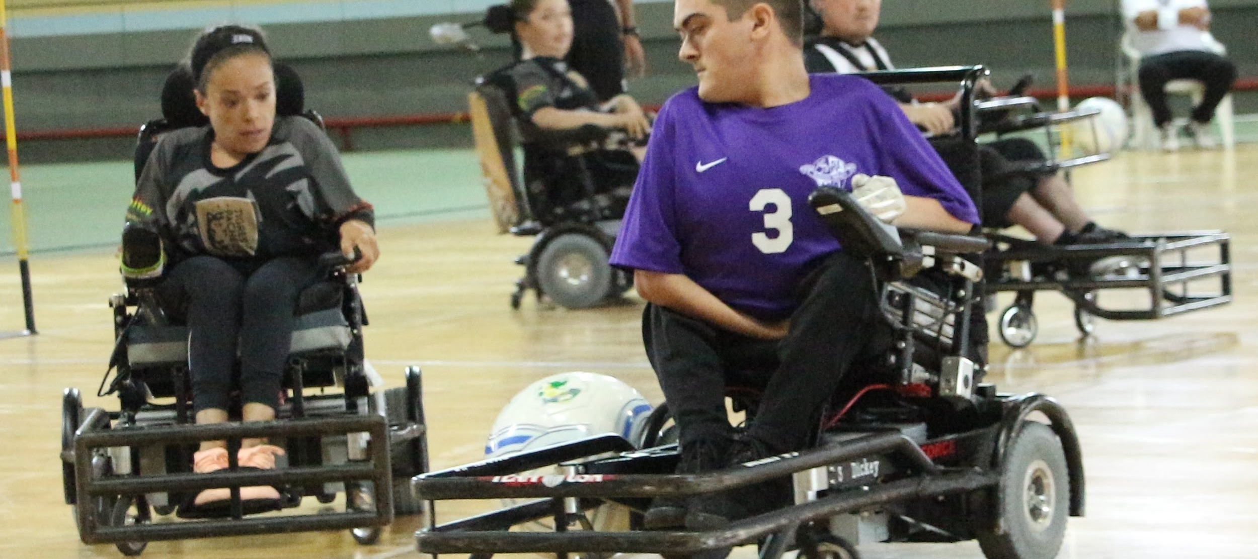
QUESTIONS?
Any Questions?

Slide 17

TRISTRAM PETERS - ASIA PACIFIC OCEANIA ZONE

Slide 18
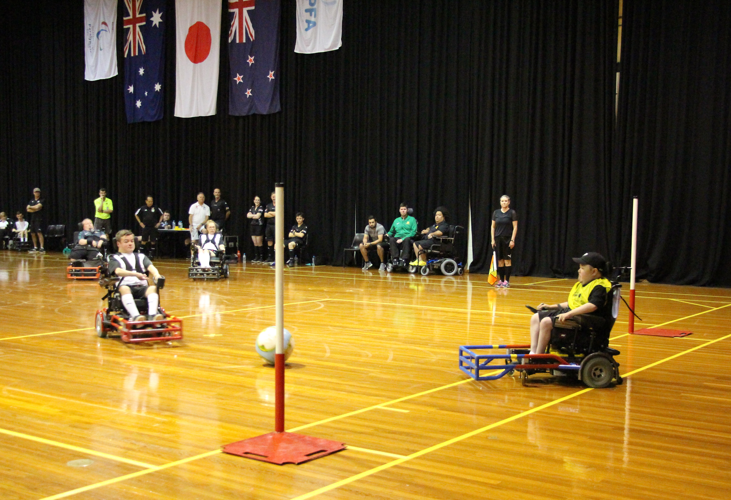
ASIA PACIFIC OCEANIA ZONE: BRIEF SUMMARY
The APO Zone currently has four members for 2022:
  Australia
  Japan
  New Zealand
  Korea
Nations developing the sport:
  India
  Singapore
  Nepal

Slide 19
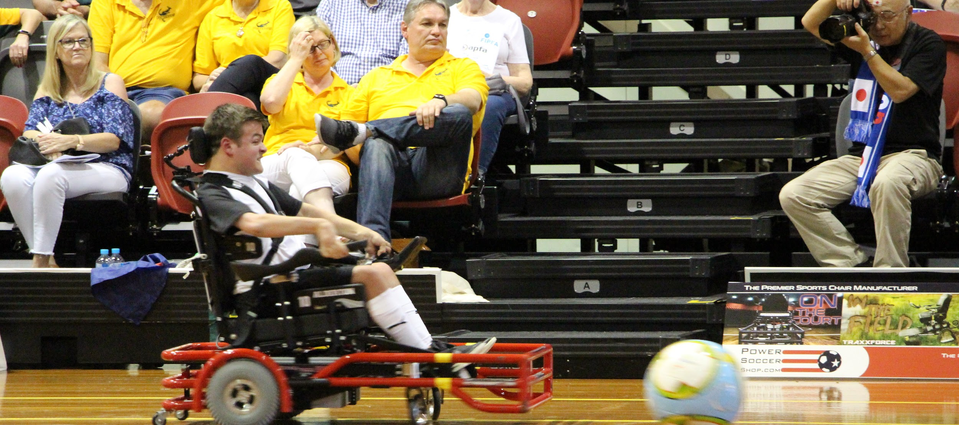
QUESTIONS?
Any Questions?

Slide 20

DONAL BYRNE - EUROPEAN ZONE

Slide 21
September - December 2021
Resumption of domestic leagues and activity.
Sports Psychology online workshops
Training Clinics for Referees and Classifiers
Football For All Leadership Programme

Slide 22


September - December 2021 - Online Sports Psychology

Slide 23
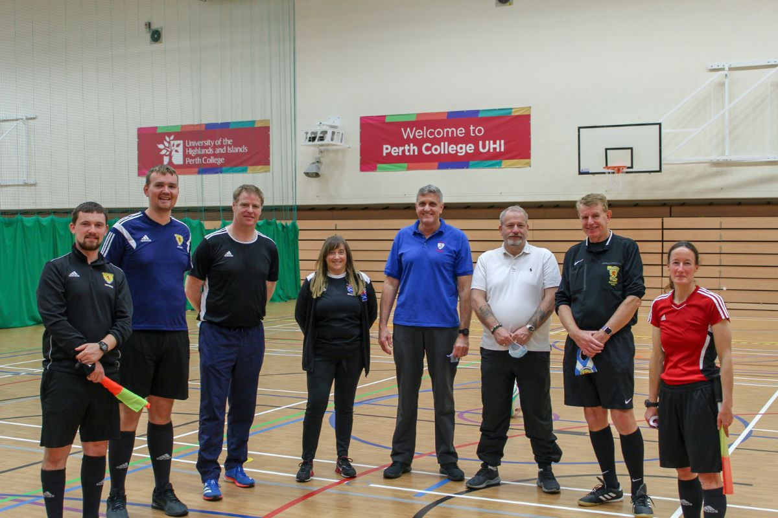
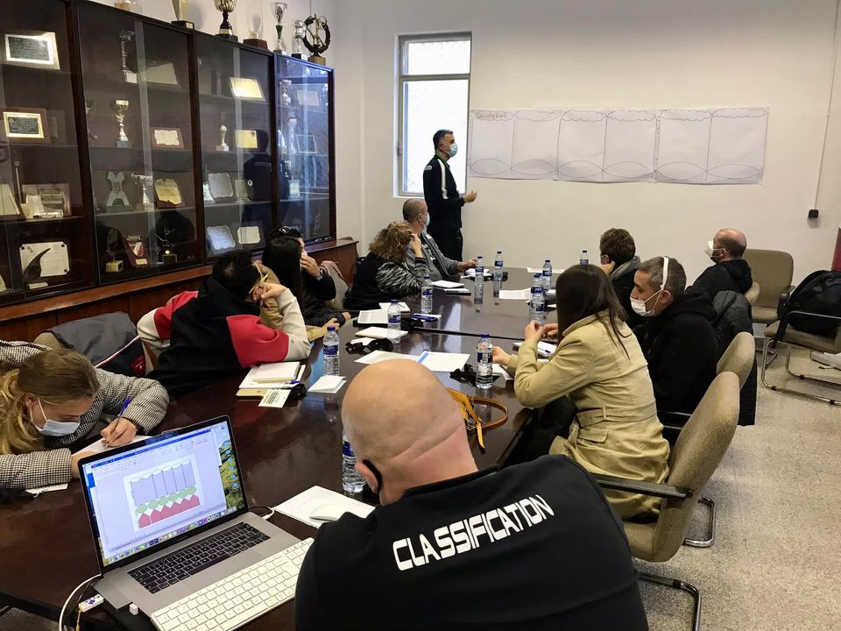
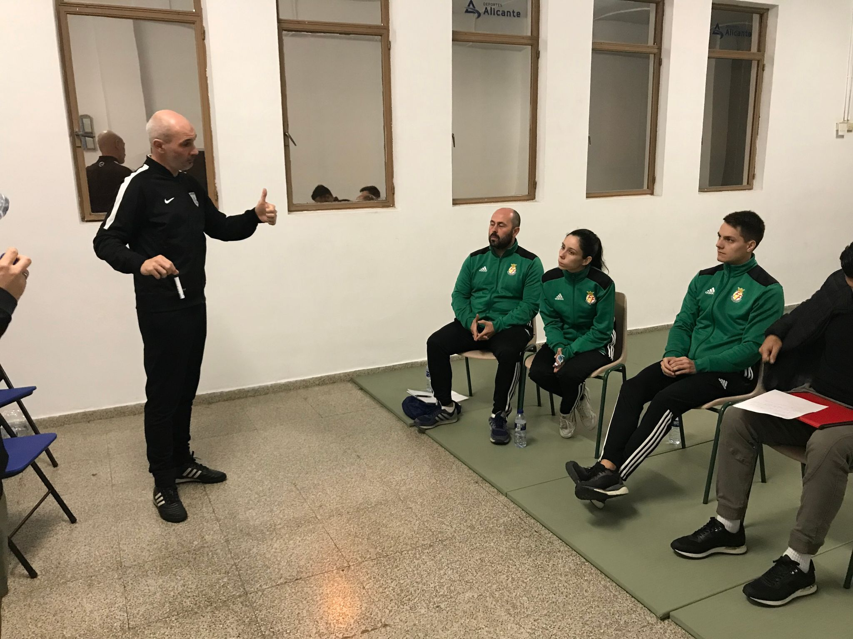
September - December 2021 - Training Clinics
Referee Clinic - Scotland and Spain

Slide 24
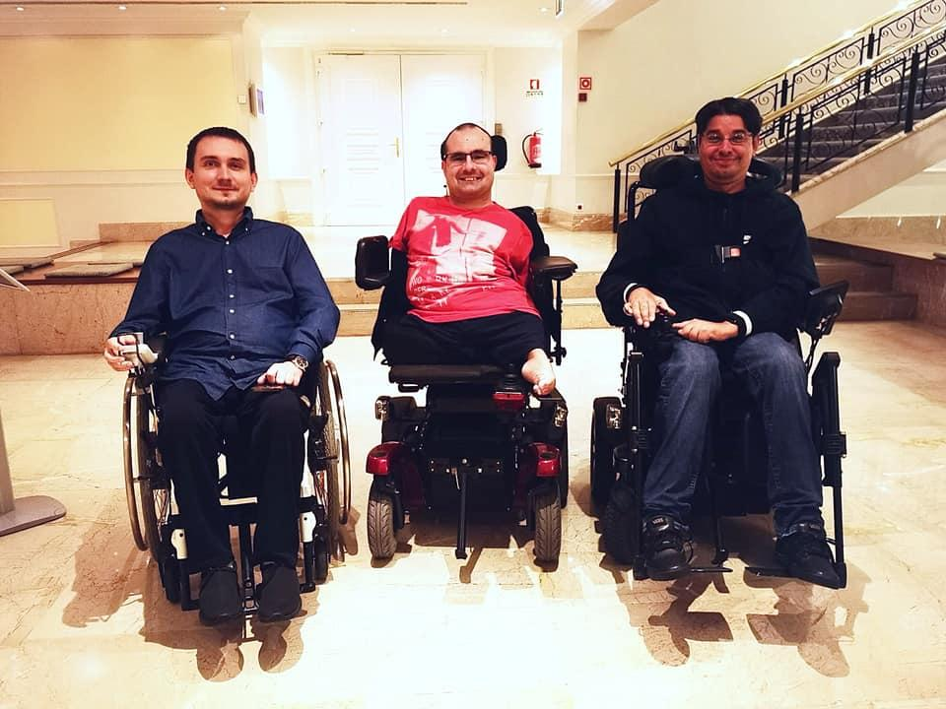
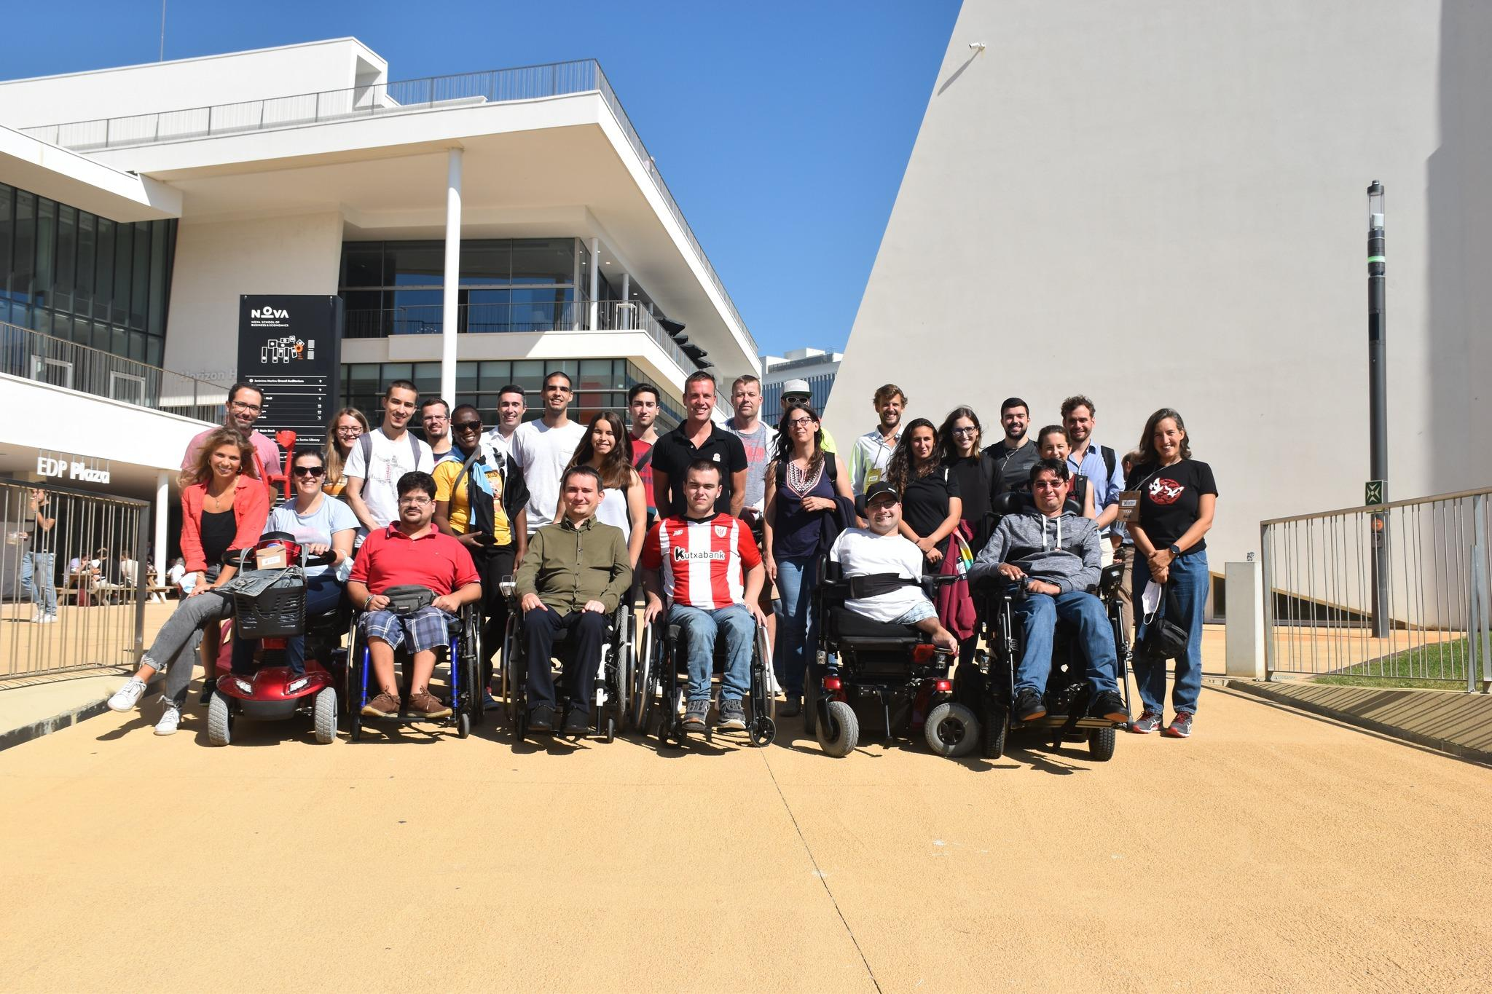
September - December 2021 - FFALP
Football For All Leadership Programme

Slide 25

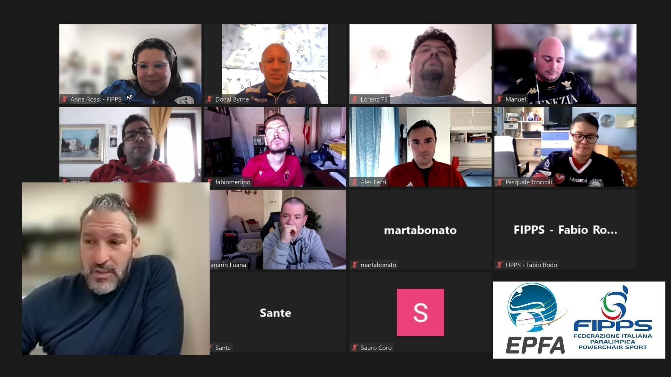
January - August 2022 - Gian Luca Zambrotta
EPFA ‘In Conversation ‘ with FIPPS

Slide 26
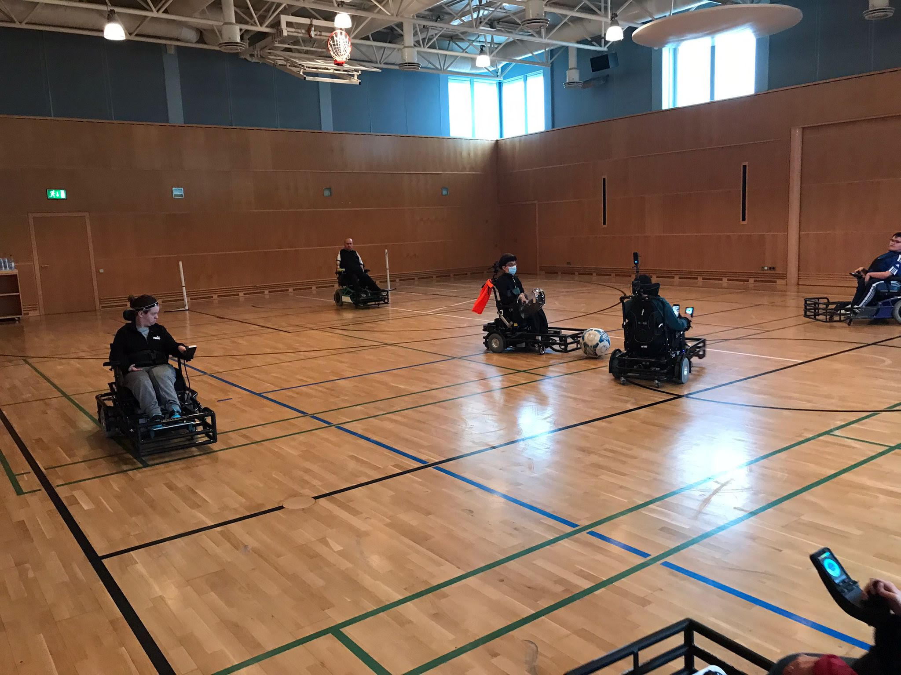
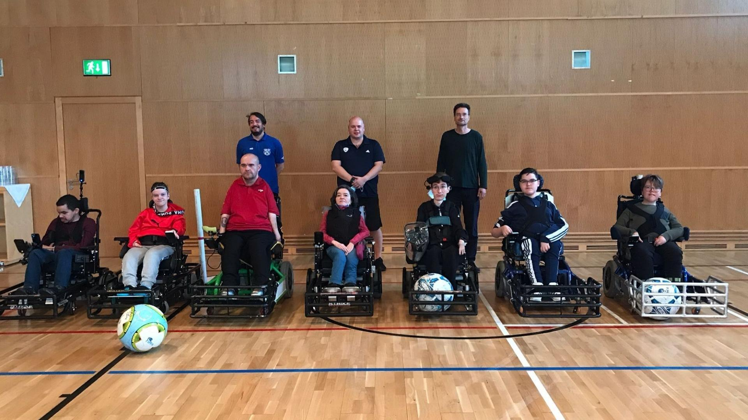
January - August 2022 - Training Clinic
Coaching Clinic - Germany

Slide 27

January - August 2022 - Home Nations Events
April and May - Newtownards, Northern Ireland

Slide 28

January - August 2022 - Home Nations Events
England, Northern Ireland, Republic of Ireland, Scotland

Slide 29
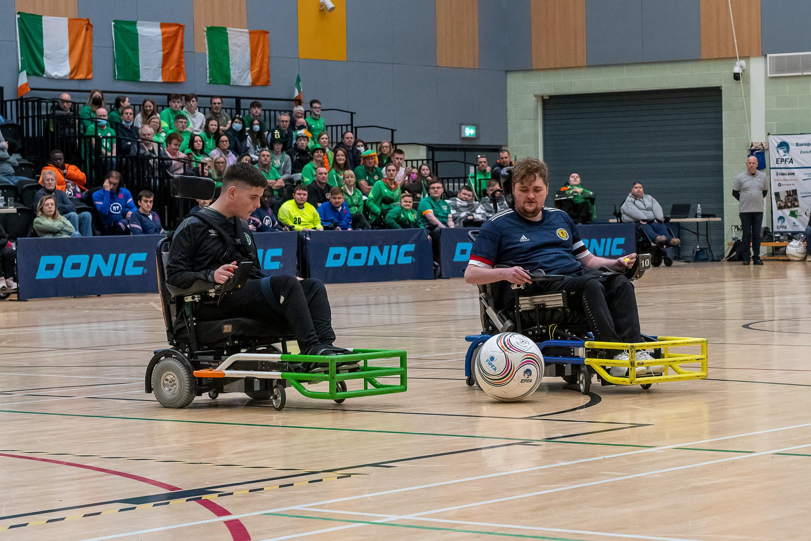
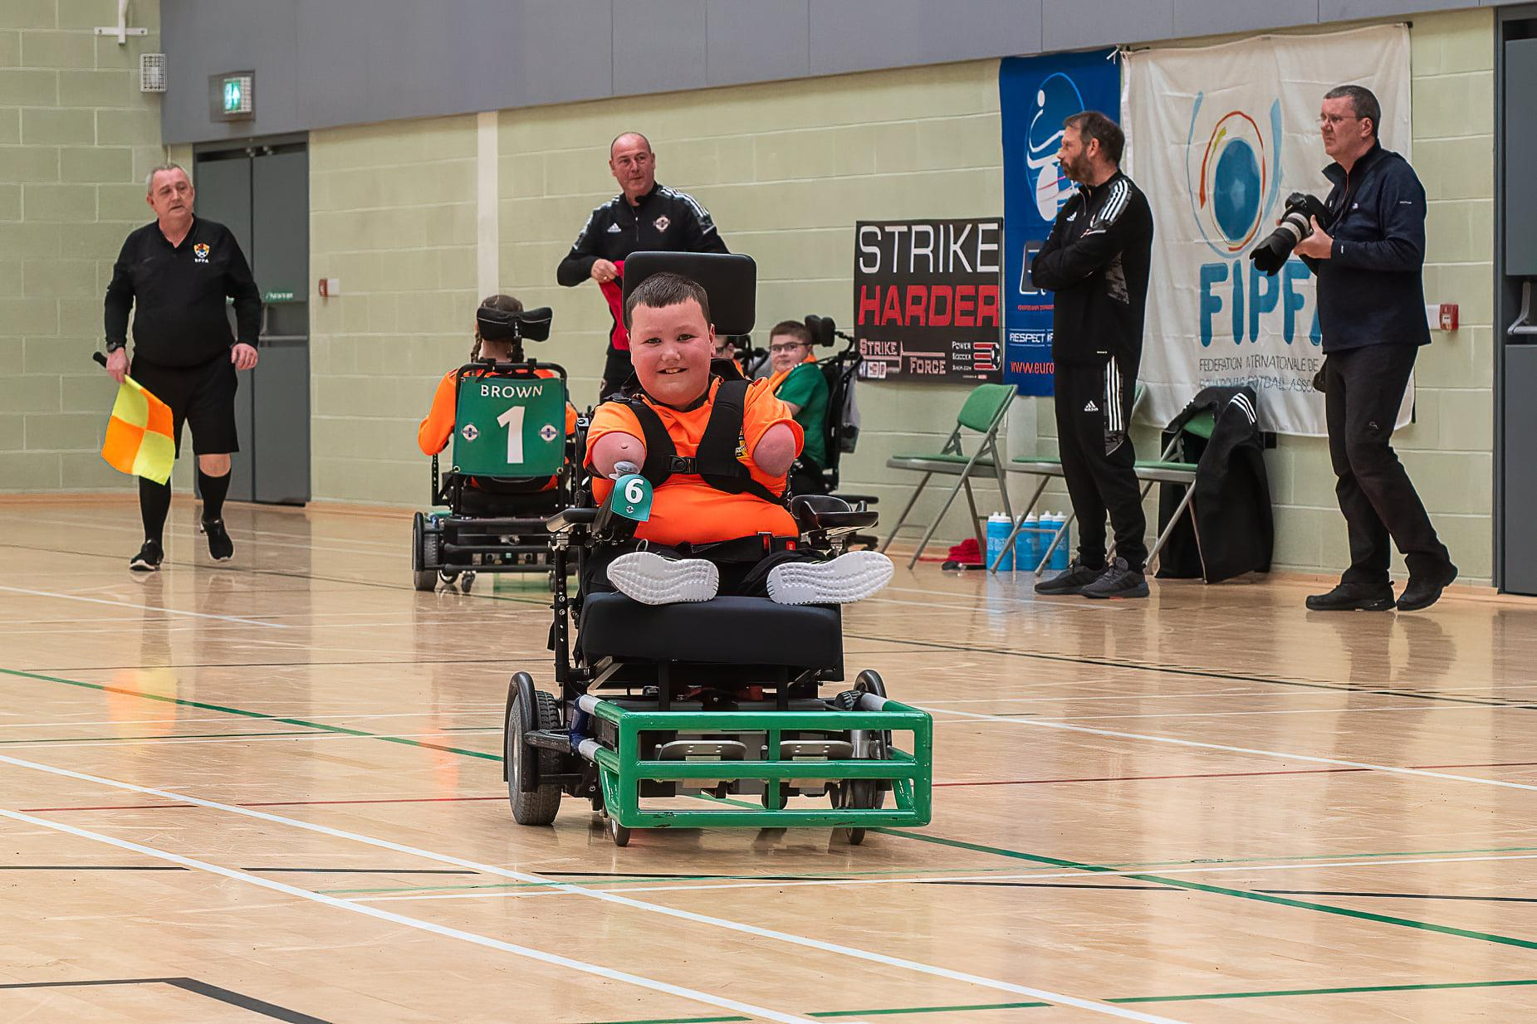
January - August 2022 - EPFA Home Nations Cup 2022
EPFA Home Nations Cup 2022

Slide 30
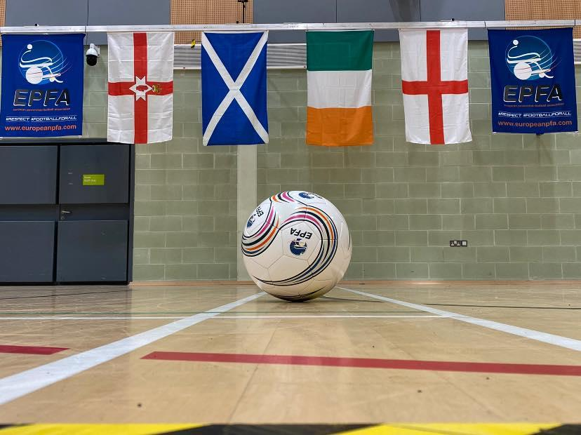
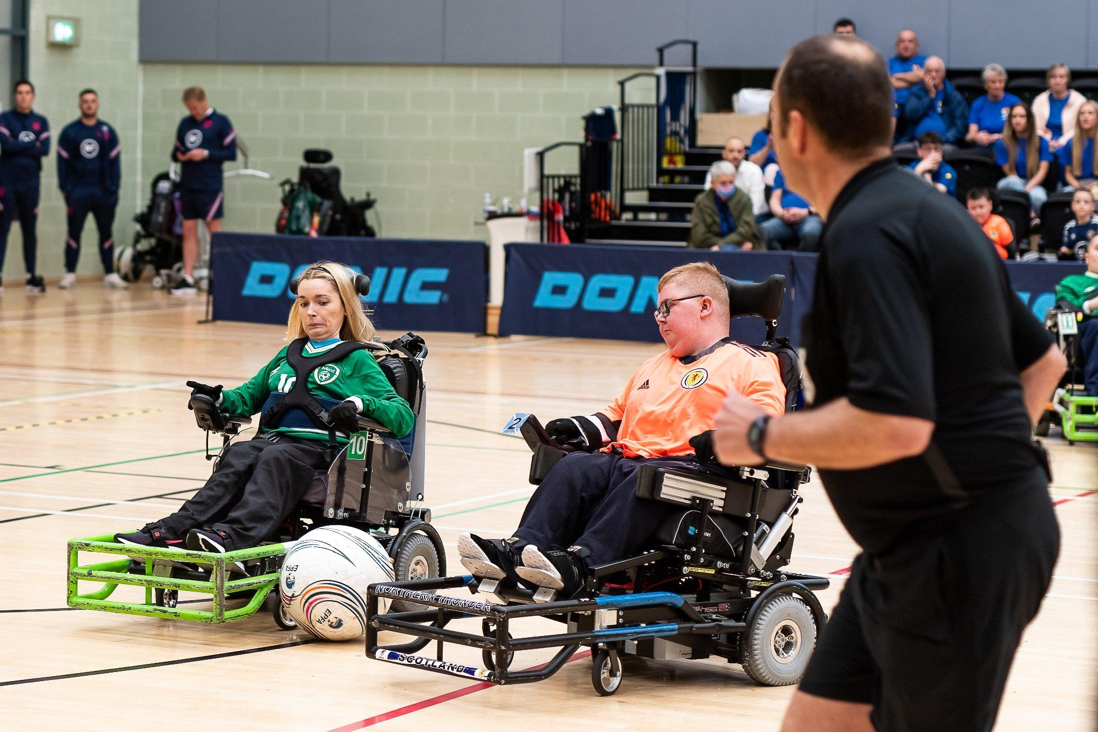
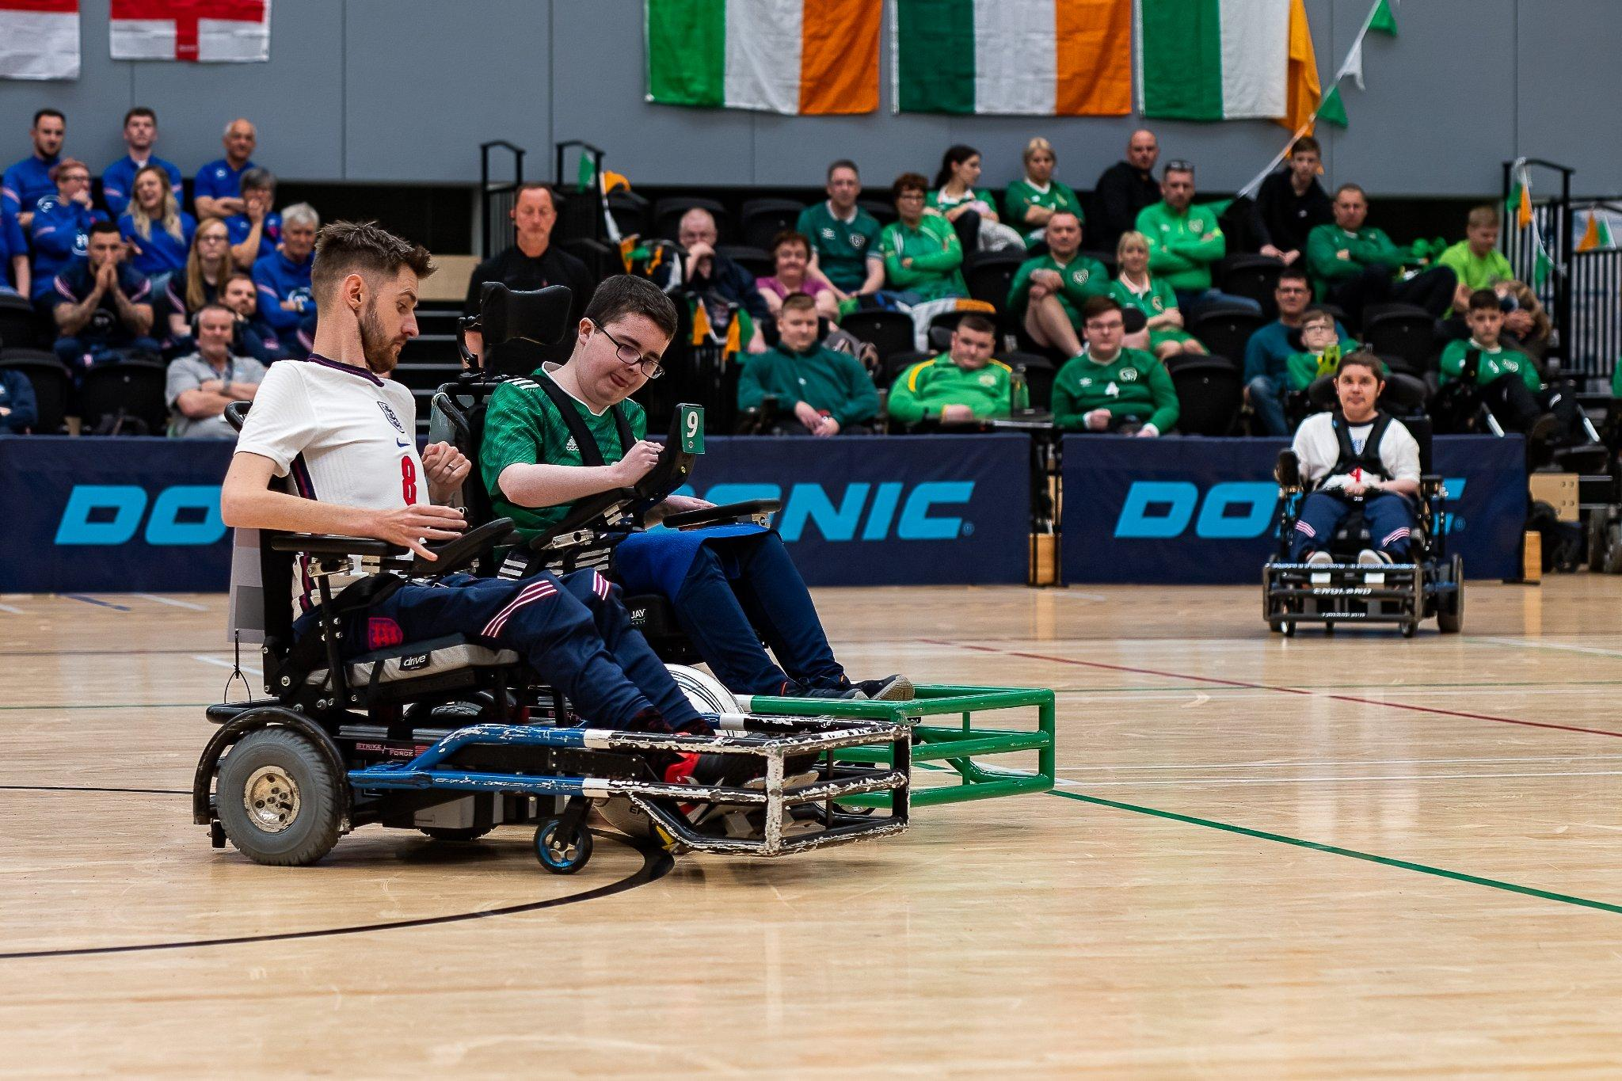
January - August 2022 - Home Nations Invitational
HOME NATIONS INVITATIONAL

Slide 31
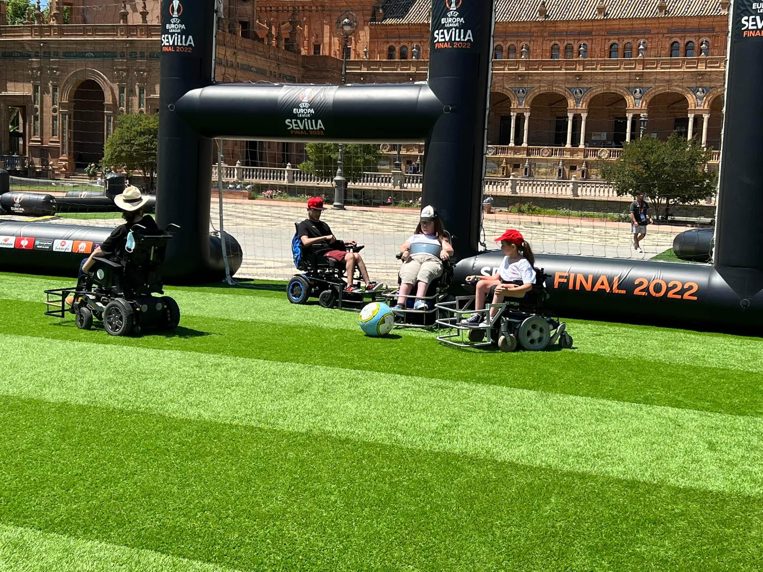
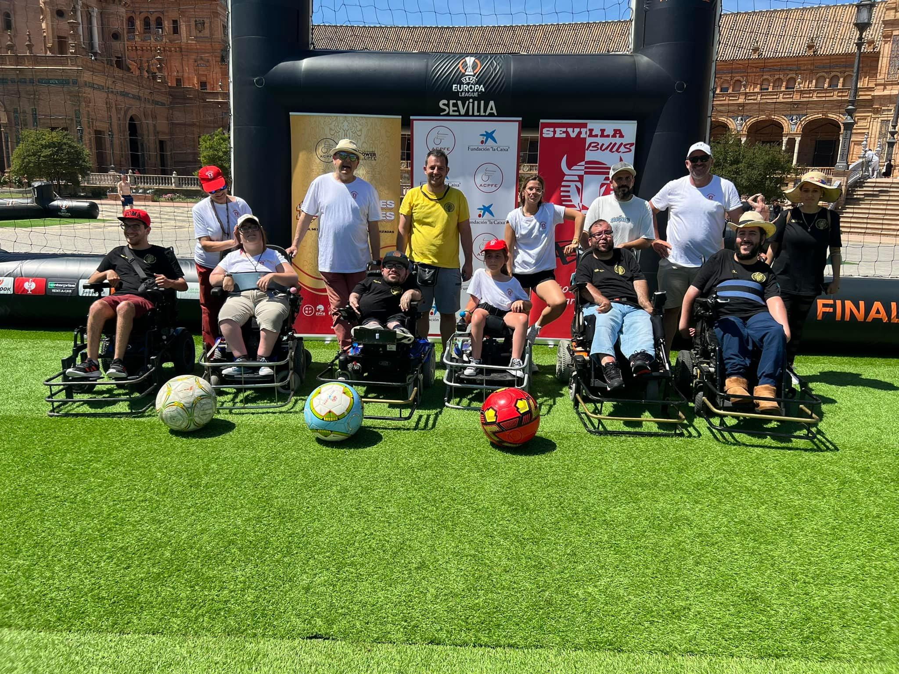
January - August 2022 - EUROPA LEAGUE Fan Festival
Europa League Fan Festival Sevilla

Slide 32
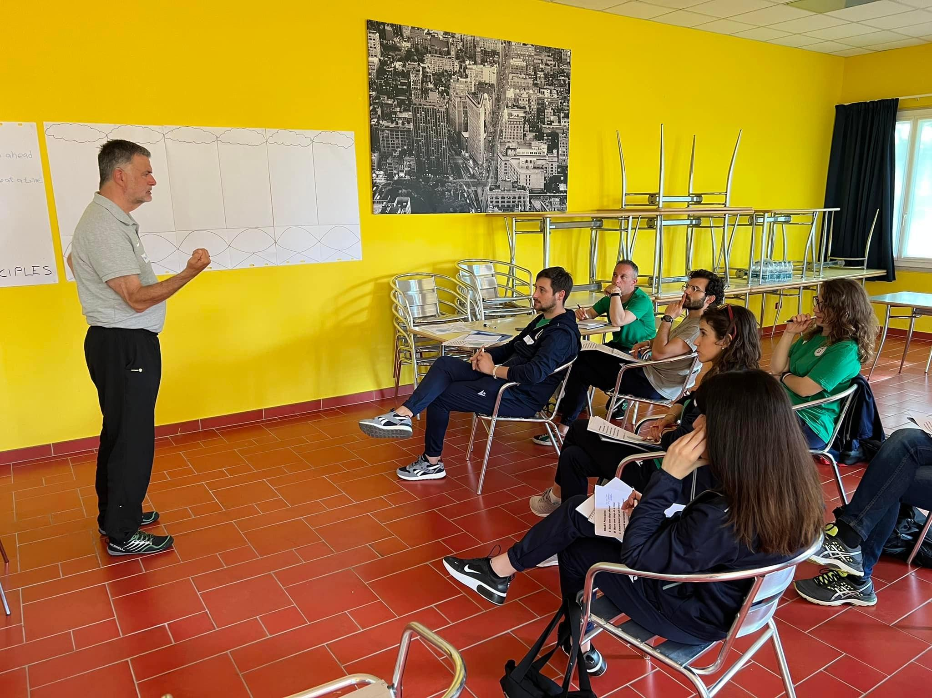
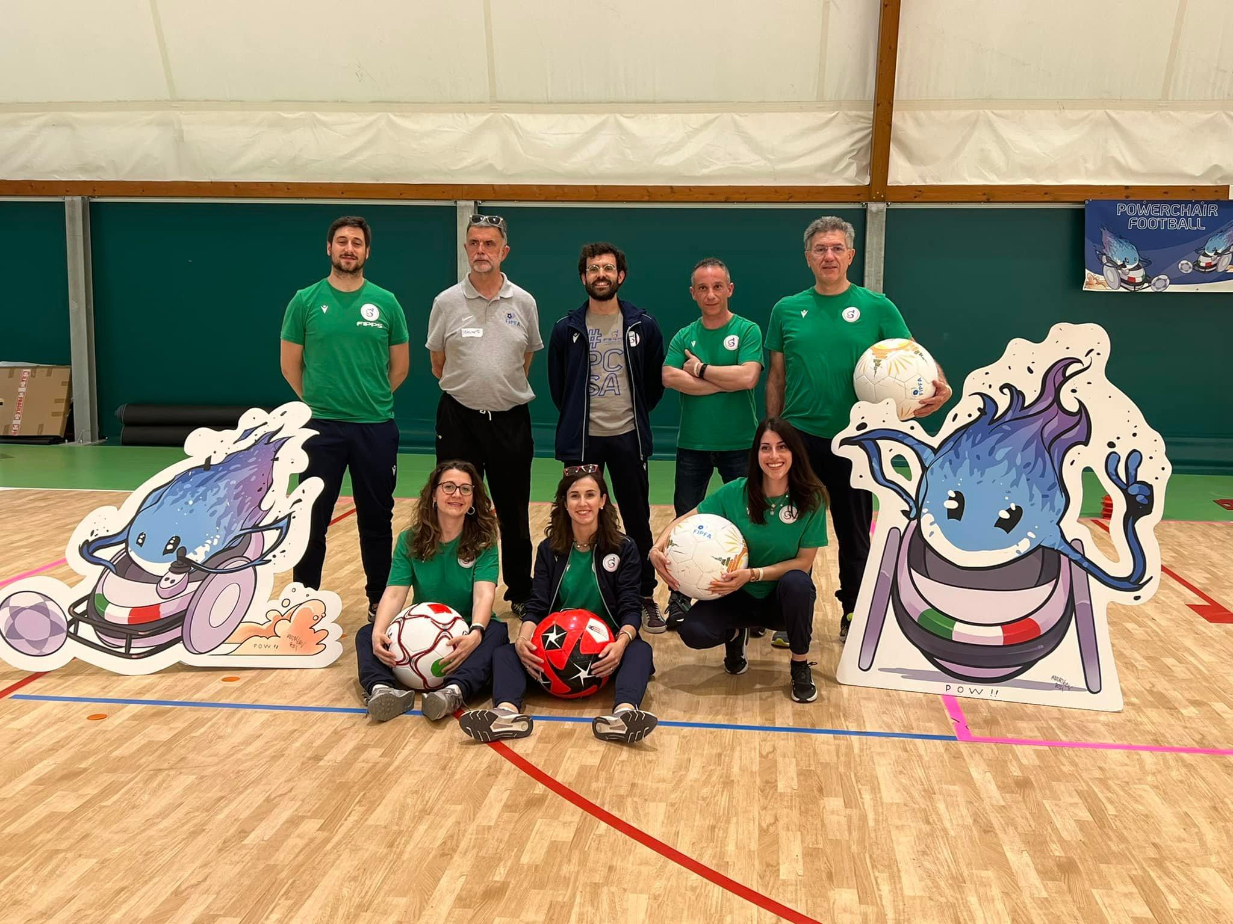
January - August 2022 - Training Clinic
Classification Clinic - Italy

Slide 33

January - August 2022 - EPFA CUP 2022

Slide 34
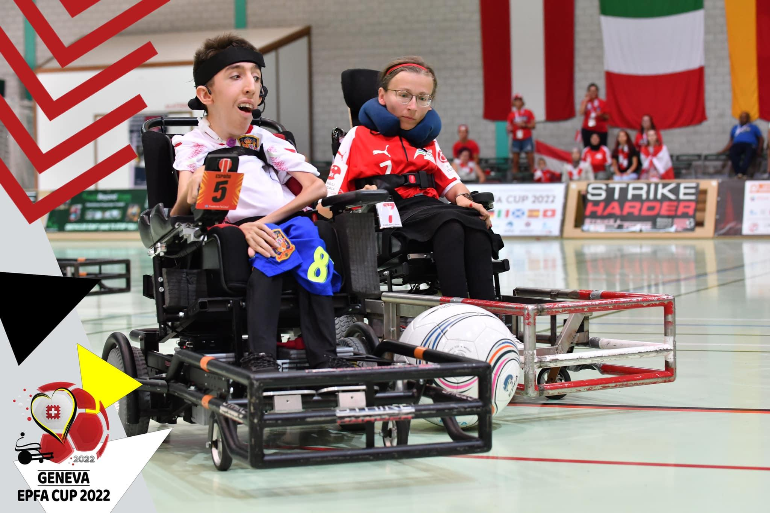
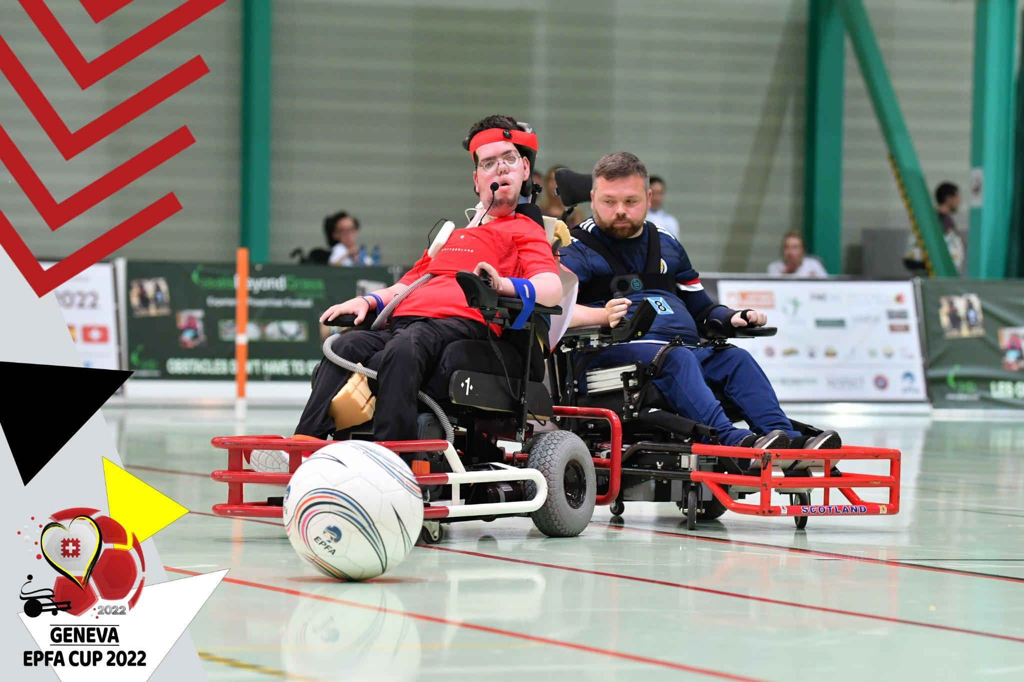

January - August 2022 - EPFA CUP 2022

Slide 35


January - August 2022 - EPFA CUP 2022

Slide 36

Future Events 2023-2025

Slide 37
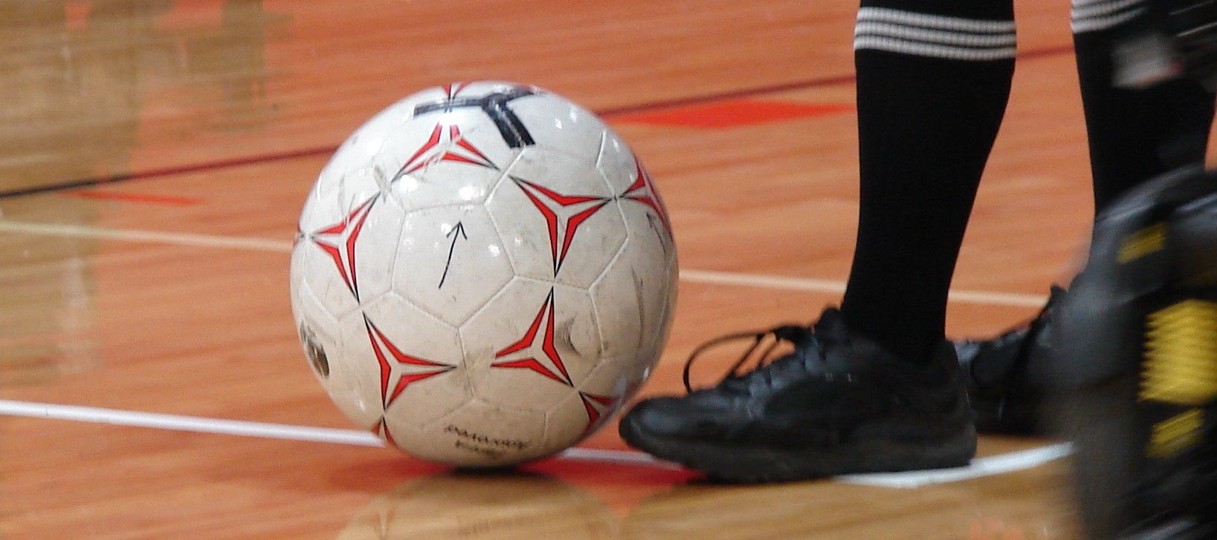
QUESTIONS?
Any Questions?

Slide 38
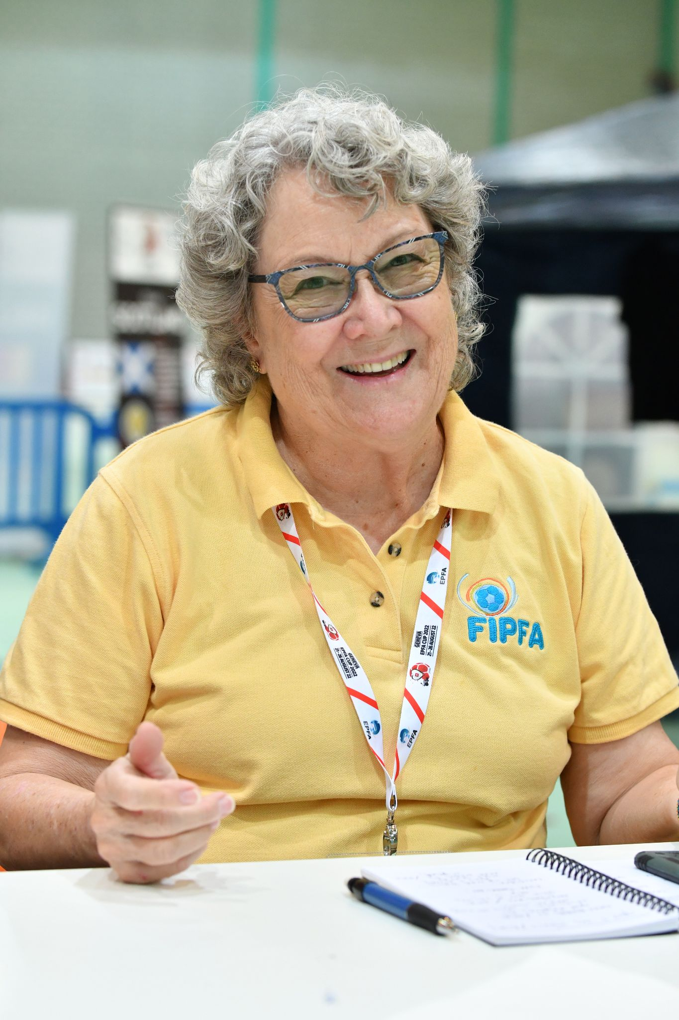
BARB PEACOCK - SECRETARY GENERAL

Slide 39
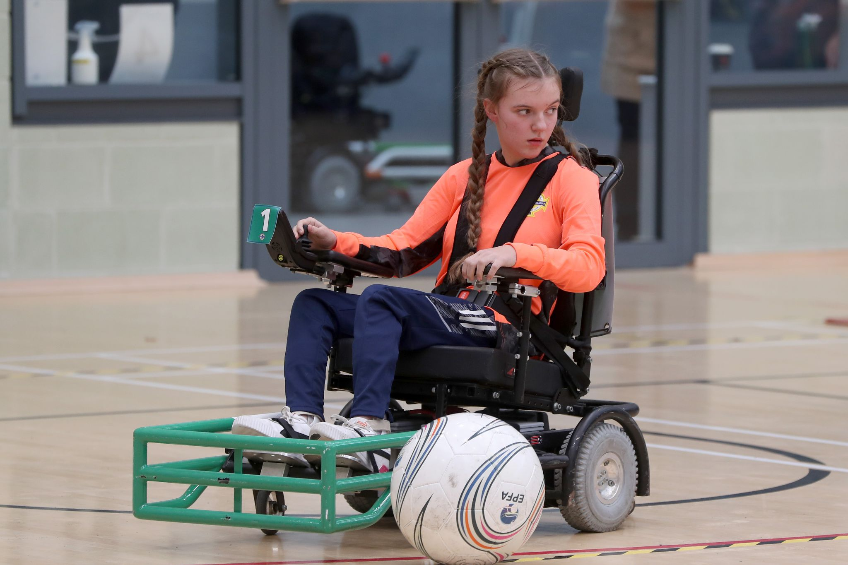
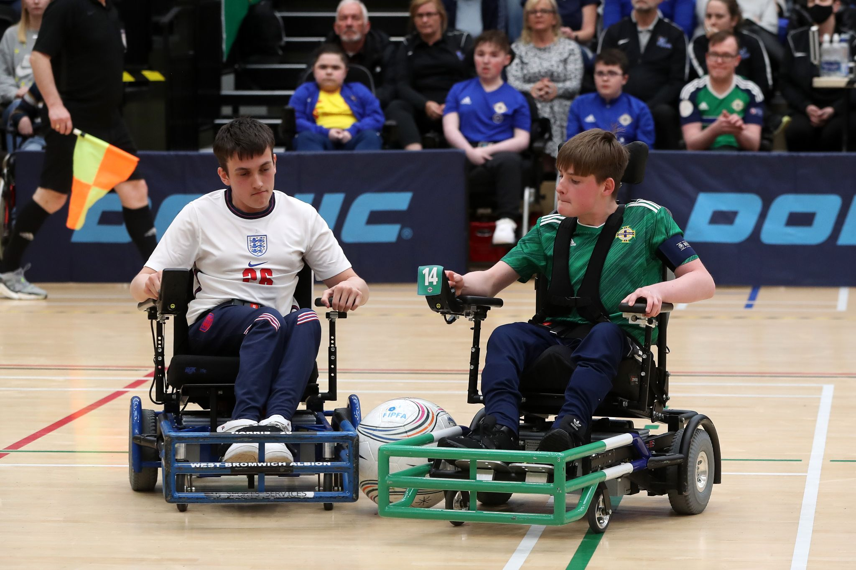
Status of the Secretariat
Duties and Responsibilities:
Manage the day to day business of FIPFA
Continue communication with Zones and NOPFs
Augment connection with partners
Request information and nominees from NOPFs
Consolidate data and information
Field issues and questions from interested parties
Organise Executive Council meetings, take notes, and disseminate minutes to ExCo members
Prepare annual reports
Organise the annual Congress.
Others as assigned by the president

Slide 40
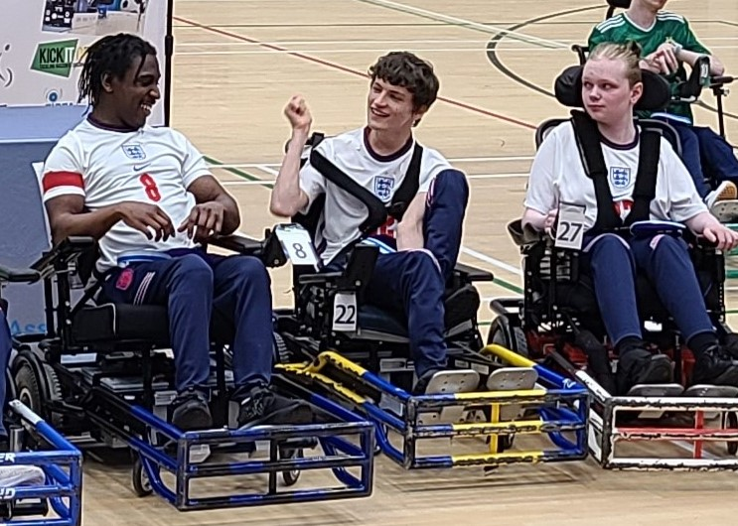
Status of the Secretariat
November 2021 - October 2022:
ExCo meetings
  Held monthly meetings with the Executive Council and the lead Zone Representatives
    Worked with FIPFA President on content
    Prepared and disseminated the agendas
    Shared the minutes from each with the ExCo.
Annual Congress
  Assisted in the preparation of the virtual Congress
  Created Minutes and disseminated to all participants

Slide 41
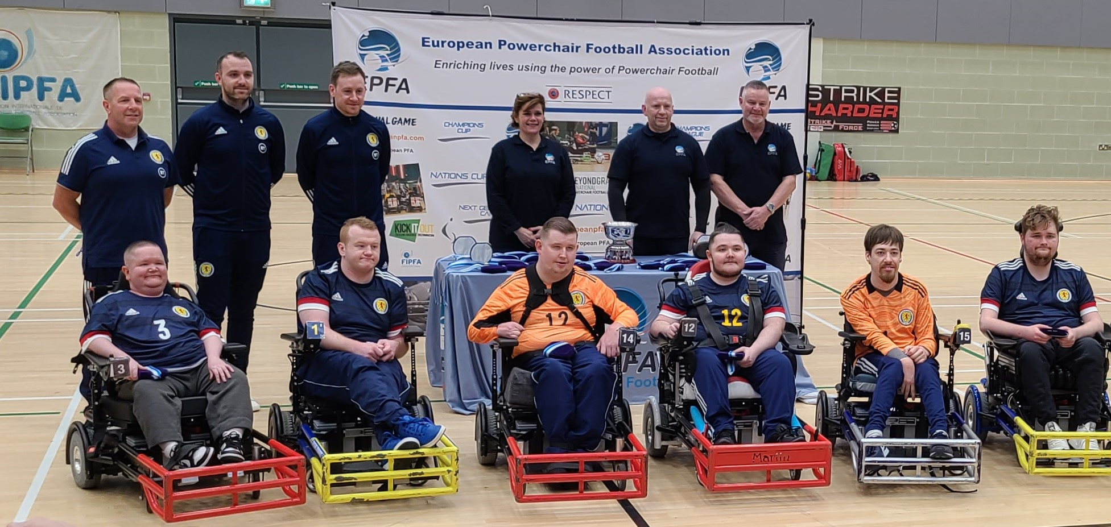
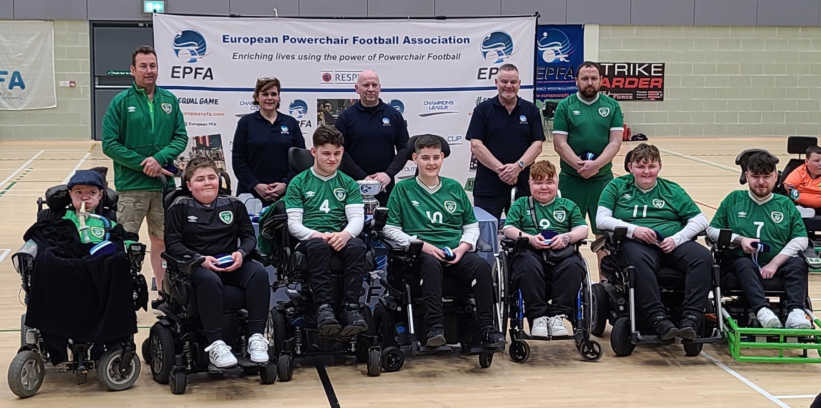
Status of the Secretariat
November 2021 - October 2022:
Prepared the Annual Report
Sent to NOPF representatives in September
IPC LA 2028 Bid
  Worked closely with Sophie Bevan, Director of Sport, to complete application
Represented FIPFA at Events
EPFA Home Nations Cup in Belfast
EPFA Cup 2022 in Geneva
Notes:
Ryan to be introduced by Barb

Slide 42
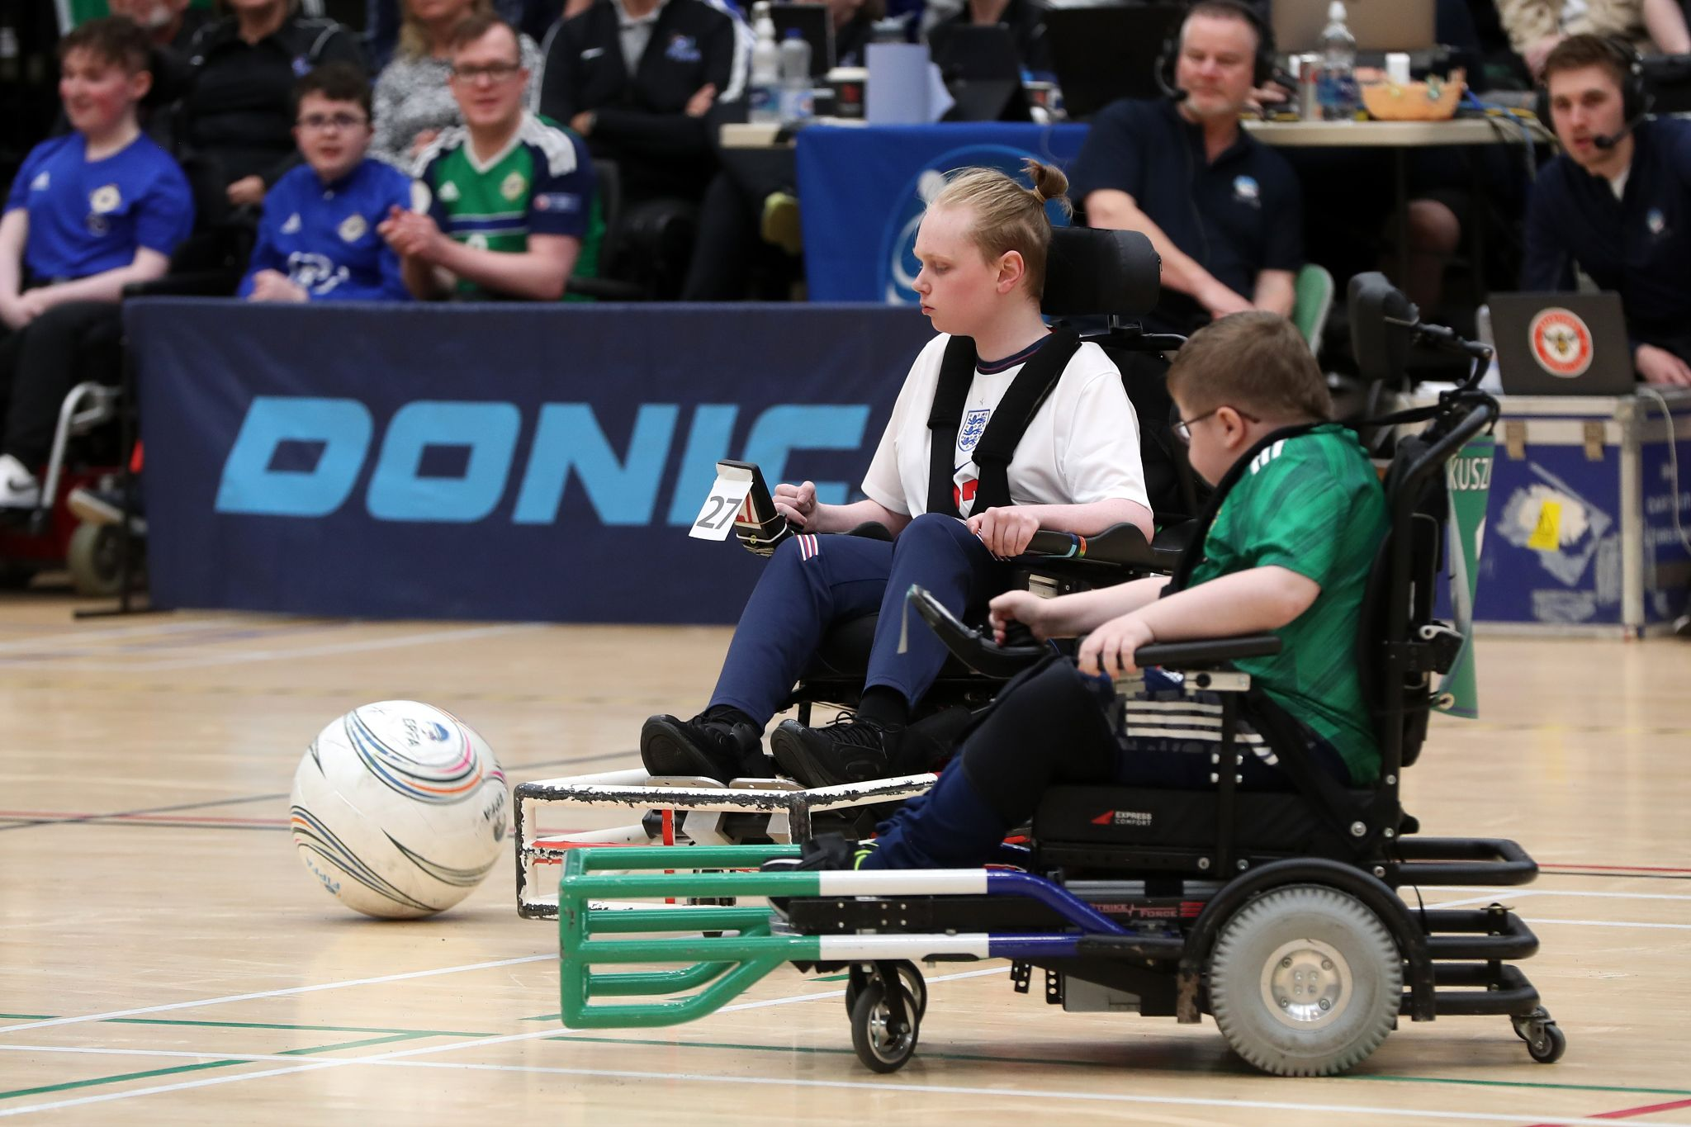
Status of the Secretariat
Goals for 2023:
Find more sponsors
Increase membership
Improve visibility of FIPFA
Continue to improve communication with Zones, NOPFs, and other countries who play the sport.

Slide 43
Status of the Secretariat - PRIORITIES
Priority is Communication –
  Important to continue to send updates to us for the website fipfa.org
      Articles, new photos, etc.
  Please keep your website active and up-to-date and make sure they are linked to fipfa.org
  Social media accounts – link with FIPFA’s
  Contact secretarygeneral@fipfa.org or communication@fipfa.org for questions and more information.

Slide 44
ELECTION INFORMATION
  Voting will be toward the end of this meeting.
    Election Runner collects the votes and reports only who voted and the final numbers. It does not show how anyone voted.
    Alex from Goals Beyond Grass will run the program and report the results.
  Only Current Full Affiliated Members will vote.
    Voting members will be sent 2 separate ballots during this meeting:
      Approval of the proposed Constitution
      Selection of President

Slide 45
ELECTION INFORMATION
  Per our constitution, both office holders and passage of any items are determined by a Simple Majority (50% + 1).
  Also, per the constitution, in the case of a tie, the President decides the outcome.
  Today:
    In the case of a tie in the approval of the new constitution vote, Ricky Stevenson, current president, will choose.
    In the case of a tie in the election of president, John Moore (IRE), Treasurer of FIPFA will choose.

Slide 46
ELECTION INFORMATION
  Election Cycle:
  In accordance with the regulations annexed to the FIPFA Constitution, the election of officers of the FIPFA Council is staggered.
 | 2022 | 2023 | 2024 | 2025
President | ELECTION
Vice President |  | ELECTION
Treasurer |  |  |  | ELECTION
Director Of Sport |  |  | ELECTION

Slide 47
BARB PEACOCK - SECRETARY GENERAL
ANNUAL
REPORT

Slide 48
2021 Review
Welcome to FIPFA's 2021 Annual Report.
We produce this report to reflect the work accomplished in the last complete calendar year.
2021 saw the return of Powerchair Football in many of our member nations. While Covid is still among us, local teams, athletes and coaches found ways to overcome the lack of play and persevere with trainings and competitions. About half of our member nations held national tournaments in 2021.
The following slides represent FIPFA in 2021.

Slide 49
2021 Membership:
In 2021 FIPFA had 24 Member Nations:
AMERICAS | EUROPE |  |  | ASIA/OCEANIA
 | FULL AFFILIATE MEMBERS
Argentina | Austria | Northern Ireland |  | Australia
Brasil | Denmark | Republic of Ireland |  | Japan
Canada | England | Scotland |  | New Zealand
United States | Finland | Spain |  | South Korea
Uruguay | France | Switzerland
 | Germany
 | ASSOCIATE MEMBERS
Mexico | Italy |  | Russia | India

Slide 50
Statistics from 2021:
Growth statistics:
 | 2021 | 2020 | 2019 | difference | %age Growth from 2019
Registered Clubs | 266 | 227 | 232 | 34 | 14.7%
Registered Teams | 423 | 385 | 374 | 49 | 13.1%
 | 2021 | 2020 | 2019 | difference | %age Growth from 2019
Referees | 383 | 360 | 308 | 75 | 24.4%
Classifiers | 49 | 49 | 41 | 8 | 19.51%
Coaches | 348 | 324 | 284 | 64 | 22.5%
This page and the next show the continued growth of our sport, despite the issues that Covid initially brought us in 2020, and still continues.

Slide 51
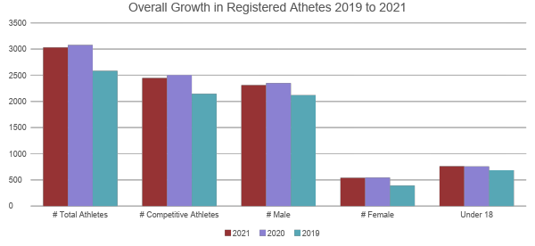
Statistics from 2021:

Slide 52
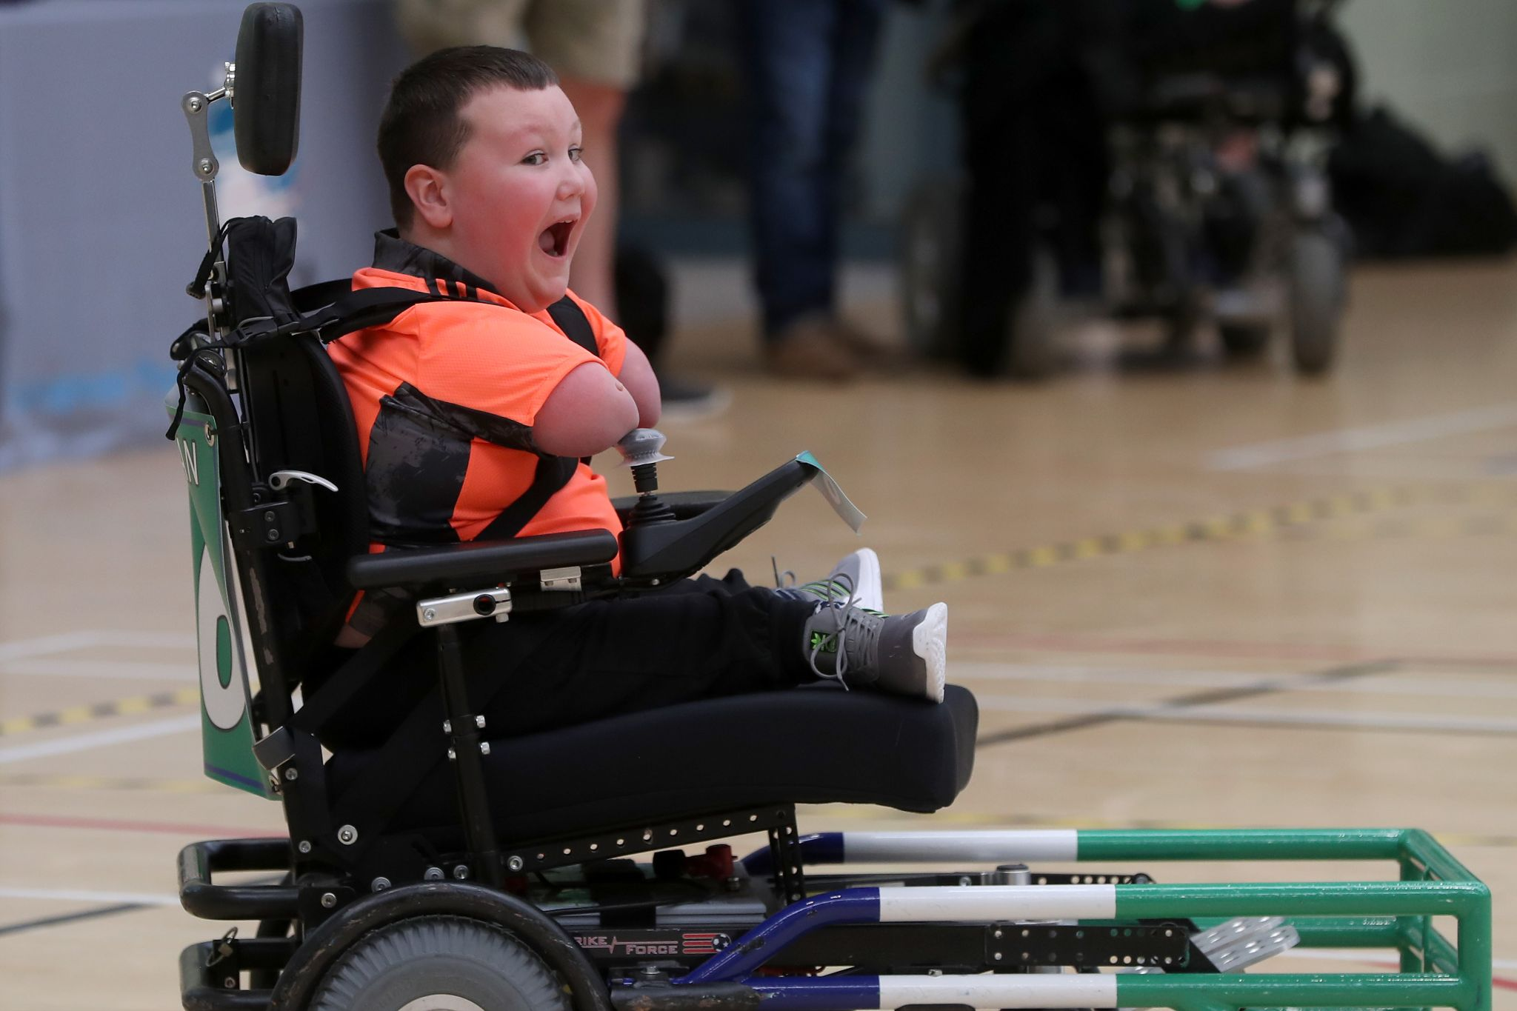
Questions?
Any questions?
Please email me at secretarygeneral@fipfa.org

Slide 53
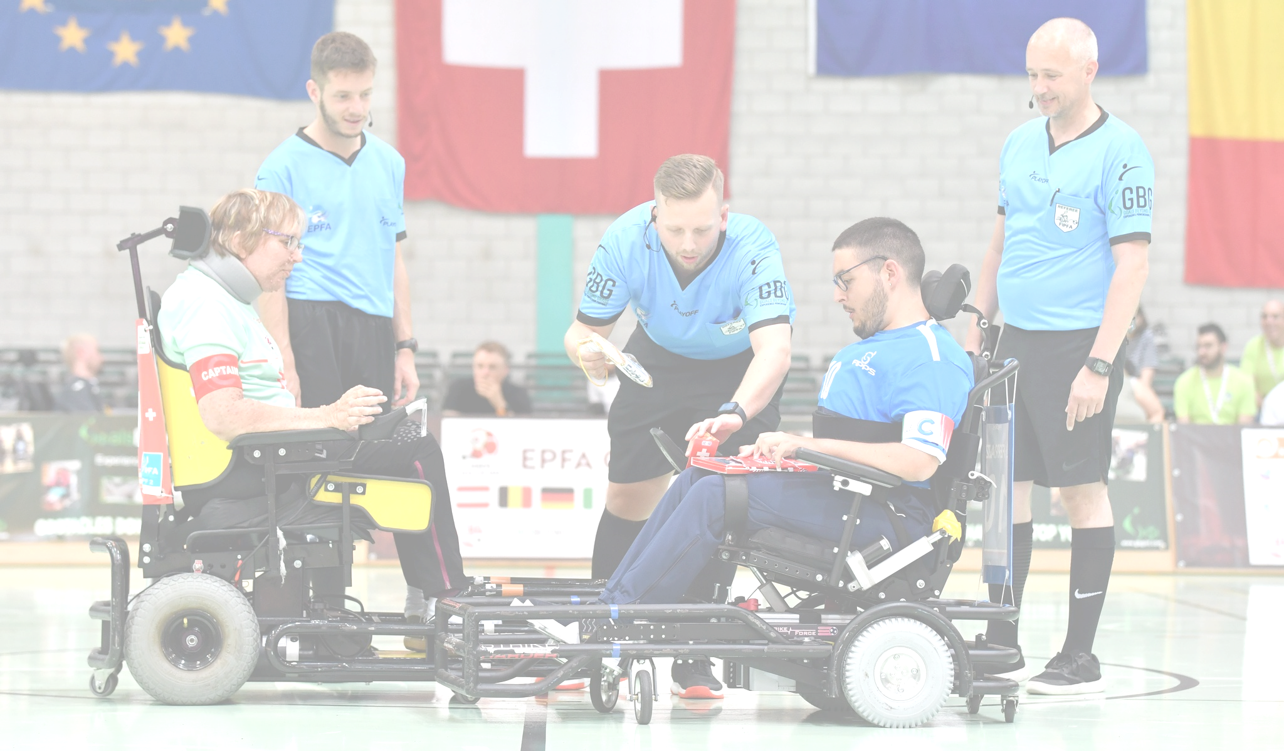
Financial Report 2021
Facebook: @Alexandra Johnson Photography

Slide 54
FINANCIAL REPORT
Treasurer’s report for 2021:
NatWest BALANCE 31/12/2021 | 63,946.52€
Remaining Balance on French Main Account | 25,760.16€
Remaining Balance on French Savings Account | 46.38€
Remaining Balance on French PayPal Account | 4697.39€
Total Accounts Balance 31/12/21 | 94,450.45€

Slide 55
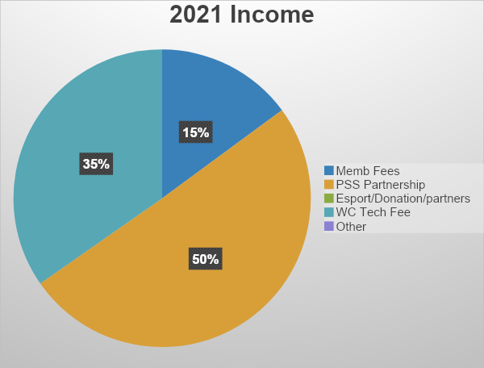
2021 INCOME
Income
2021 Membership Fees | 10.300.00 €
PSS Partnership | 34,790.00 €
Esport/Donation/Partnership | 0.00 €
Technical Fees for WC 2023 | 23,970.00 €
Other | 0.00 €
Total Income | 69,060.00 €

Slide 56
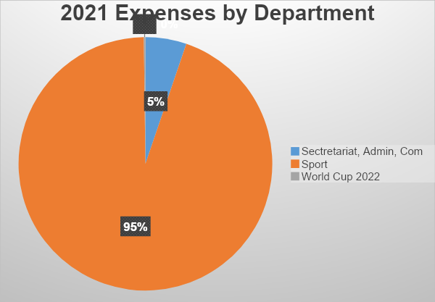
2021 EXPENSES
Expenditures by Department
Executive Committee/Board | 0.00 €
Secretariat, Administration, and Communications | 417.81 €
Sports Department | 7,562.55 €
Development | 0.00 €
Esport | 0.00 €
Zones | 0.00 €
World Cup 2023 | 16.00 €
Total | 7,996.36€
See next slide for detail

Slide 57
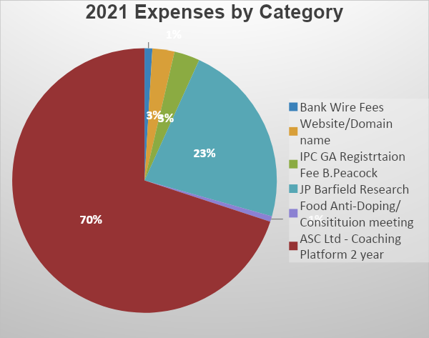
2021 EXPENSES
 | Sectretariat, Admin, Com | Sport | World Cup 2022
Bank Wire Fees | 5.81 € | 54.00 € | 16.00 €
Website/Domain name | 162.00 € | 54.00 €
IPC GA Registration Fee B.Peacock | 250.00 €
JP Barfield Research |  | 1,806.81 €
Food Anti-Doping/ Constitution meeting |  | 54.44 €
ASC Ltd - Coaching Platform 2 year |  | 5,593.30 €
Subtotals: | 417.81 € | 7,562.55 € | 16.00 €
Total Expenses | 7,996.36 €

Slide 58
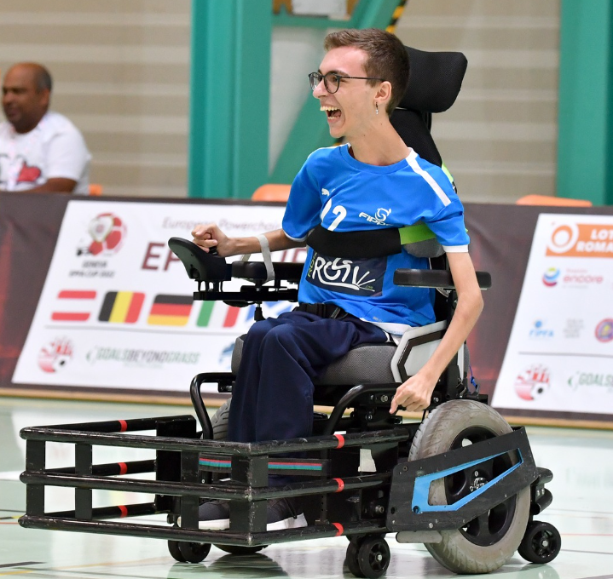
Questions?
Any questions?
Please email me at treasurer@fipfa.org

Slide 59
Reflections 21/22
2021 Reflections
(November 2021 – October 2022)

Slide 60
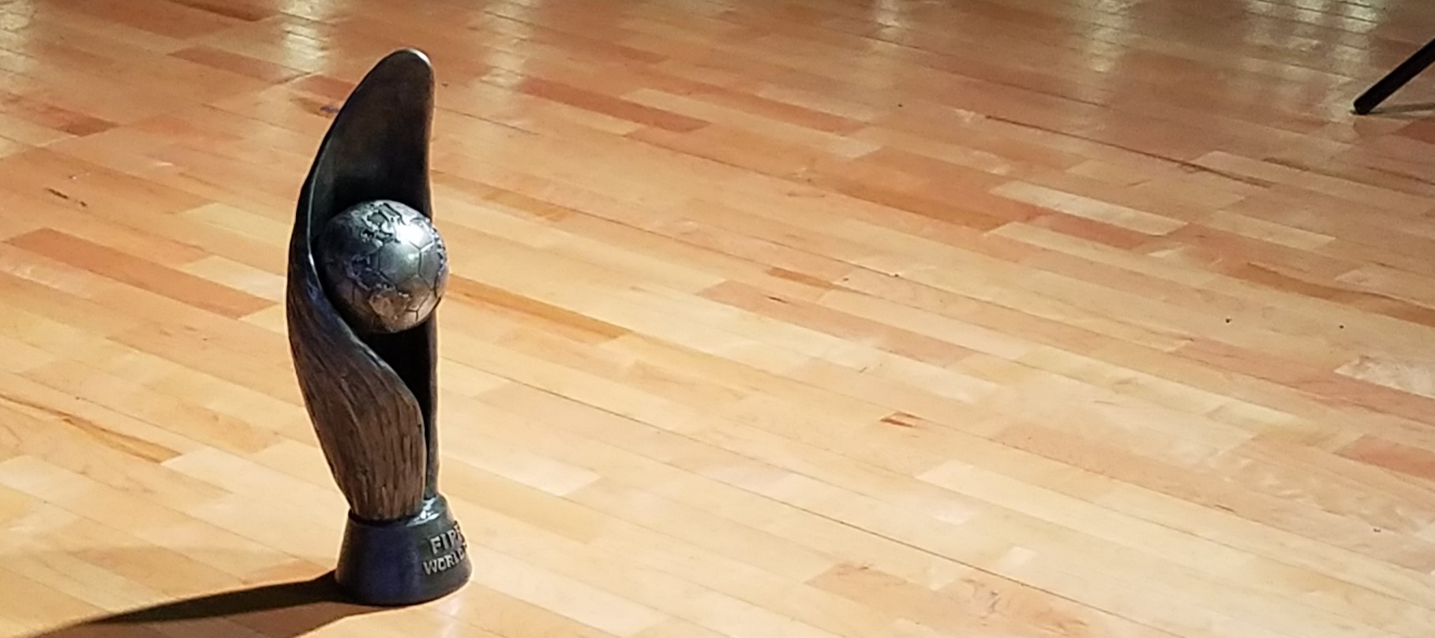
QUESTIONS?
Any Questions?

Slide 61


PARTNER UPDATES
  2021: Continued partnership with Power Soccer Shop a division of NEMI as our Elite Partner
  2021: Continued partnership with YOOLA as our Travel Partner
  2021: Continued membership as International Federation of IPC - Application submitted for LA 2028 Paralympic Games

Slide 62




PARTNER UPDATES
  Continued members of Para Football (body of football for persons with disabilities).
  Continued partnership with Goals Beyond Grass to support technology- database and website
  2nd Year of partnership with ASC Cloud (Sports Session Planning Platform).
  FIFA - collaboration on resource for FIFA member nations around disability football

Slide 63
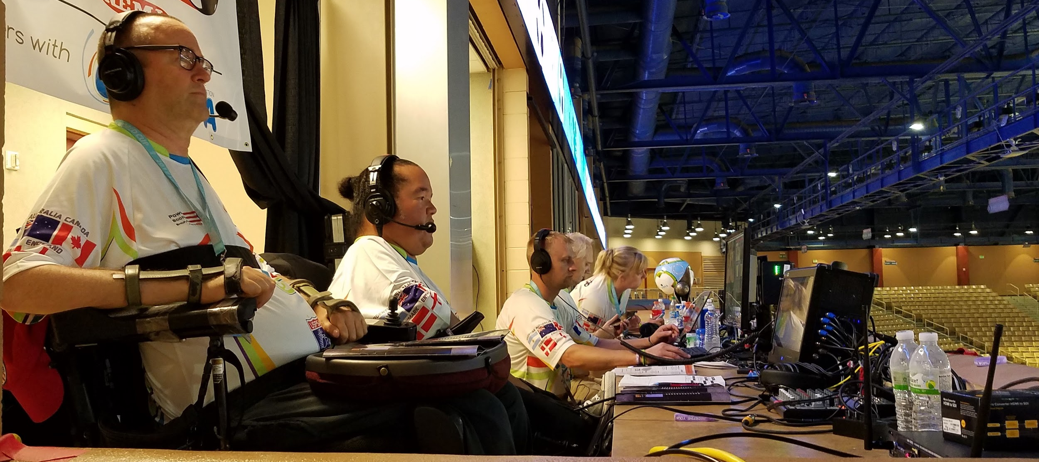
QUESTIONS?
Any Questions?

Slide 64

FIPFA Powerchair Football World Cup 2023

Slide 65
2023 Powerchair Football World Cup Update
  Confirmation of Qualified Nations
  Hosts
Australia
  EPFA Qualified Nations
England
France
Ireland
Denmark
Northern Ireland
  APFC Qualified Nations
USA
Uruguay
Argentina
  APO Qualified Nations
Japan

Slide 66
2023 Powerchair Football World Cup Update
Andy Harper – Chair of the Local Organising Committee

Slide 67
QUESTIONS?
Any Questions?

Slide 68
Sport Department Updates
Sophie Bevan

Slide 69
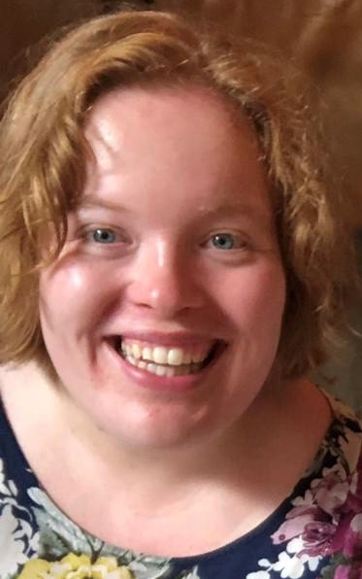
SOPHIE BEVAN- DIRECTOR OF SPORT

Slide 70
Sport Department Update
Technical Update
We are going to form a technical committee who work together on the many different technical aspects of our sport which will be lead by a technical officer.
In early 2023, we will be advertising to all member nations, on social media and on our website for applications. We would encourage anyone interested to apply. Full role profile and further details will be provided.
APPOINTED OFFICER
APPOINTED OFFICER
VACANT
Florent Bokobza (FRA)

Slide 71
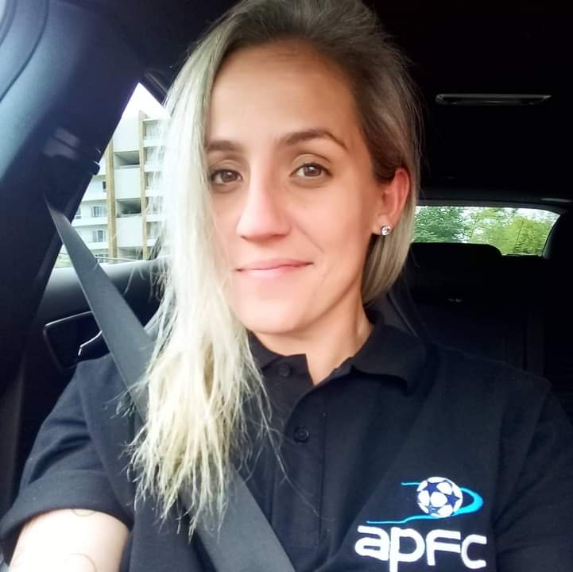
Sport Department Update
Competitions Update
APPOINTED OFFICER
We have supported 3 sanctioned events this year as zones worked hard to get back on court following covid-19 pandemic
We would encourage all zones to send us their calendar of events for 2023 onwards so we can begin to plan for necessary support if events are to be sanctioned
We will be reviewing the sanctioning documents throughout 2023 to improve the application process but until then remind member nations that FIPFA asks for a minimum 6 months notice of event for paperwork to be received by Director of Sport
APPOINTED OFFICER
Hanna Kwitko
(BRA)
Nicolas Dubes (FRA)

Slide 72
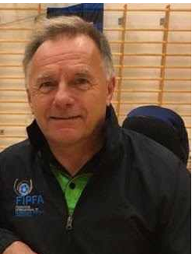

Sport Department Update
APPOINTED OFFICER
APPOINTED OFFICER
Referees Update
Martin Bevan
(ENG)
Florent Bokobza (FRA)

Slide 73
Sport Department Update
Referees Update
It has been a relatively quiet year for me as head of referees. There continues to be development around the zones, with our main focus on the team for the World Cup next year.
We are wanting to ensure, as always that we have the very best referees at our premier event.
APPOINTED OFFICER
APPOINTED OFFICER
Martin Bevan
(ENG)
Florent Bokobza (FRA)

Slide 74
Sport Department Update
Referees Update continued - Referees – Supported Events / Training
There have been events in Europe this year that were sanctioned by FIPFA.
We were hoping to use one of these events to sign off more referees for the 2023 World Cup but that wasn’t possible. This should happen early in 2023.
APPOINTED OFFICER
APPOINTED OFFICER
Martin Bevan
(ENG)
Florent Bokobza (FRA)

Slide 75
Sport Department Update
Referees Update continued - Referees – Plans & Priorities 2022/3
Road to World Cup 2023: prepare a Log which can be updated by zones, for the potential referee candidates to participate in WC. I have asked all Zone Heads to update me on the candidates for the WC, on their participation in their country and zone events
Make a handbook with recommendations for referees.
Work with the Directors Referees of Zones, in the detection of future talents.
APPOINTED OFFICER
APPOINTED OFFICER
Martin Bevan
(ENG)
Florent Bokobza (FRA)

Slide 76
Sport Department Update
Referees Update continued - Workshop on Laws of the game
Venue: TBD according to budget
Participants: Two referees selected by FIPFA from each of the participating countries. Australia, England, France, Ireland, Denmark, Northern Ireland, USA, Argentina, Uruguay, Brazil and Japan (Total 20 Ref). If available, but ensure best referees only attend.
Duration: 2/3 Days, with classroom and court works. Possibly to coincide with a FIPFA sanctioned event. Not possible by zoom as the timescale and timezones would rule this out.
APPOINTED OFFICER
APPOINTED OFFICER
Martin Bevan
(ENG)
Florent Bokobza (FRA)

Slide 77
Sport Department Update
Referees Update
APPOINTED OFFICER
APPOINTED OFFICER
Any Questions?
Please email Martin at referee@fipfa.org
Martin Bevan
(ENG)
Florent Bokobza (FRA)

Slide 78
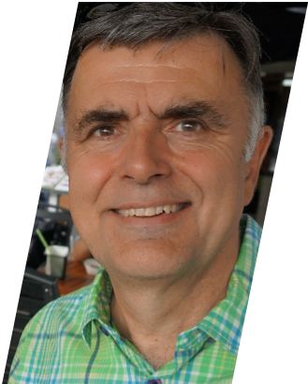
Sport Department Update
APPOINTED OFFICER
Classification Update
Stewart Evans
(ENG)

Slide 79
Sport Department Update
Classification Update
As competitions begin to be planned and held in the zones it is encouraging to see the levels of participation maintained. The same cannot be said for the maintenance of classifiers.
The extreme hiatus caused through Covid has meant that classifiers have modified their priorities or do not have a national organisation that use classification rules in their respective leagues have not had opportunity to use their skill for in some cases, 3-4 years.
APPOINTED OFFICER
Stewart Evans
(ENG)

Slide 80
Sport Department Update
Classification Update
Subsequently in recent zonal events that have been held, recruitment of classifiers has been a challenge. This is a matter we intend to resolve by polling existing classifiers and checking their levels of commitment and looking to promote existing national classifiers from NOPF’s who have invested in classification and utilise it in their national leagues.
In addition we are looking to run classification courses to train prospective candidates for national leagues across all zones. Please get in touch if you wish to be involved
APPOINTED OFFICER
Stewart Evans
(ENG)

Slide 81
Sport Department Update
Classification Update
The Postgraduate research project being undertaken in Virginia USA by Dr JP Barfield and his team is nearing completion. The potential changes proposed are strongly in line with current assessment practice, but unites with the requirements of the IPC for a quantitative research approach.
The team should be ready to finalise the assessment programme, and fully blend with the current classification system in the late summer of 2023. It is planned to introduce it as a demonstration model at the World Cup for full implementation during the next quadrennial.
APPOINTED OFFICER
Stewart Evans
(ENG)

Slide 82
Sport Department Update
Classification Update
The provision of a national level database that is fully integrated into the International version is fully up and running and all NOPF’s are warmly invited to sign up and utilise this system.
Reminder that the cost for NOPF’s to use database nationally is £400 (€466)
Some adaptation of the database to integrate the new quantitative assessments will be required but this is a matter that can be managed by the designer of the database and Dr Barfield’s IT team at the university.
APPOINTED OFFICER
Stewart Evans
(ENG)

Slide 83
Sport Department Update
Classification Update
It is anticipated that there will be a change in classification leadership and all NOPF’s will be kept informed, but the operational side of classification will continue as before, closely following IPC guidelines in order to support our application for full participation at Paralympic events.
APPOINTED OFFICER
Stewart Evans
(ENG)

Slide 84
Sport Department Update
Classification Update
APPOINTED OFFICER
Any Questions?
Stewart Evans
(ENG)

Slide 85
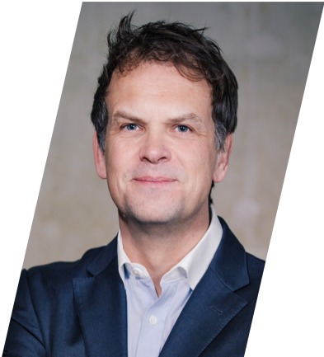
Sport Department Update
APPOINTED OFFICER
Anti Doping Update
Graham Arthur
(ENG)

Slide 86
Sport Department Update
Anti-Doping Update - Strategy
An effective operational anti-doping program is an important part of the sport’s growth and development strategy.
This program is necessary to support public authority engagement and major event participation.
APPOINTED OFFICER
Graham Arthur
(ENG)

Slide 87
Sport Department Update
Anti-Doping Update - Operational Development
Anti-doping operations first require players and player support to be aware of key matters concerning anti-doping.
This is a fundamental requirement of the World Anti-Doping Code.
APPOINTED OFFICER
Graham Arthur
(ENG)

Slide 88
Sport Department Update
Anti-Doping Update - Education & Communication
Essential features include –
• Doping Control process
• Information, practice and guidance regarding the process for obtaining exemptions for the use of medications.
• Supplement and nutrition risk awareness
APPOINTED OFFICER
Graham Arthur
(ENG)

Slide 89
Sport Department Update
Anti-Doping Update - Education & Communication
Progress
In person education sessions to teams and staff
▸May 2022 – Ireland, Northern Ireland, England & Scotland
▸August 2022 – Austria, Belgium, Germany, Italy, Spain, Switzerland
APPOINTED OFFICER
Graham Arthur
(ENG)

Slide 90
Sport Department Update
Anti-Doping Update - Next Steps
Development should continue with:
Further team, staff and support awareness
Localised online training resources
Risk analysis with WADA
TUE Process
Testing Plan
APPOINTED OFFICER
Graham Arthur
(ENG)

Slide 91
Sport Department Update
Anti-Doping Update
APPOINTED OFFICER
Any Questions?
Graham Arthur
ENG

Slide 92
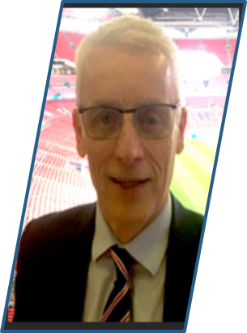
Sport Department Update
APPOINTED OFFICER
APPOINTED OFFICER
Coaching Update
Jeff Davis
(ENG)
Florent Bokobza (FRA)

Slide 93
Sport Department Update
Coaching Update
Appointed by FIPFA in December
Started our partnership with Academy Sports Coach and their exclusive AscCloud® software to support the development of our coaching opportunities.
The AscCloud® Platform provides a dedicated resource to support the development and growth of educational and coaching programmes for Para athletes and coaches.
APPOINTED OFFICER
APPOINTED OFFICER
Jeff Davis
(ENG)
Florent Bokobza (FRA)

Slide 94
Sport Department Update
Coaching Update
We gave trial licenses to interested coaches who attended the workshops we ran online in 2020.
If anyone would like a trial or would like to purchase full access following the trial period please contact Jeff at coaching@fipfa.org or Sophie at sport@fipfa.org for more information
APPOINTED OFFICER
APPOINTED OFFICER
Jeff Davis
(ENG)
Florent Bokobza (FRA)

Slide 95
Sport Department Update
Coaching Update
Looking forward, we are hoping to create a coaching network and community which collaborates and shares good practice for the good of the game.
Through ASC we will set up forums for coaches around the world to help guide, support and educate those involved in powerchair football.
Jeff will set up virtual masterclasses with the coaches in the game, as well as develop a Coaches Working Group to help formulate a Level one course and produce resources to support all those who choose to work within this area of the game.
APPOINTED OFFICER
APPOINTED OFFICER
Jeff Davis
(ENG)
Florent Bokobza (FRA)

Slide 96
Sport Department Update
Coaching Update
APPOINTED OFFICER
APPOINTED OFFICER
Any Questions?
Jeff Davis
(ENG)
Florent Bokobza (FRA)

Slide 97
QUESTIONS?
Any Questions?

Slide 98

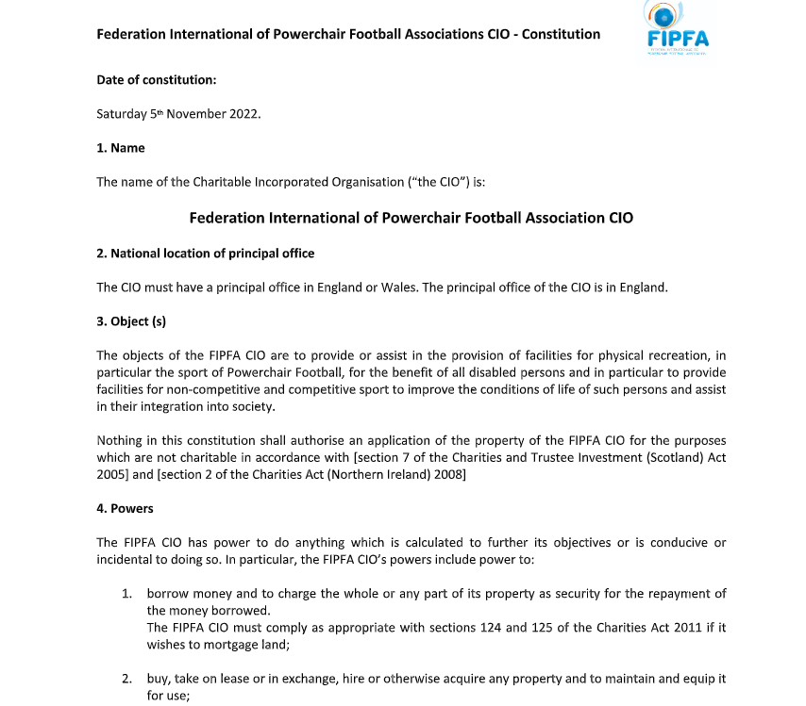
Constitution Update:

Slide 99

Constitution Update:

Slide 100
ELECTIONS 2022

Slide 101
ELECTION INFORMATION
  Voting will begin now.
    Ballots have been emailed to the designated voter during this meeting.
  Only Current Full Affiliated Members will be allowed to vote.
    1 vote per delegation on each item.
  Your ballot consists of 1 item:
    Selection of President

Slide 102
ELECTION INFORMATION
  Votes will be tallied automatically by Election Runner, a program that collects the votes and reports only who voted and the final numbers. It does not show how anyone voted.
  Alex Dowding from Goals Beyond Grass will run the program and report the results.
  Both office holders and passage of items are determined by a Simple Majority (50% + 1) per our constitution.
  In the case of a tie, John Moore (IRE), Treasurer of FIPFA will choose.

Slide 103




VOTING PROCEDURES
Please vote now.

Slide 104
CONCLUSION

