Slide 1
CONGRESS OF THE FEDERATION INTERNATIONAL OF POWERCHAIR FOOTBALL 2021 DATE: November 6, 2021 Microsoft Teams 12:00 PM – 2:00 PM UK Time
Welcome
You will be muted, but don’t worry
We will get started at 12pm

Slide 2
TEAMS DIRECTIONS
Mute Microphone
Raise your ‘hand’ to ask a question
Type ‘QUESTION’ in the chat box
Up to you if you want your camera on
We will be recording the session

Slide 3
TEAMS DIRECTIONS
REMEMBER TO SPEAK SLOWLY!
This will help everyone to be able to understand you and some of our members will need time for translations.

Slide 4
BARB PEACOCK - SECRETARY GENERAL
Roll Call
All attendees will be asked to identify themselves and attendance will be noted.
NOTE: This meeting will be recorded via Teams for future reference

Slide 5
TODAY’S AGENDA
Introduction by Ricky Stevenson, President
Reports:
Zone reports:
Americas Zone – Pablo del Puerto
Asia/Oceania Zone – Tristram Peters
European Zone - Donal Byrne

Slide 6
TODAY’S AGENDA (continued)
Reports (continued):
Barb Peacock, Secretary General:
Status of the Secretariat
Review of Voting Procedures/Voting Rights
2020 Annual Report
2020 Financial Report included
Ricky Stevenson, President:
2020/21 Reflections
Partner Updates

Slide 7
TODAY’S AGENDA (continued)
Reports (continued):
FIPFA World Cup 2022 Update by Andy Harper, Chair of LOC
Sport Department Update by Sophie Bevan, Director of Sport
Constitution Update by Ricky Stevenson, President
Background Information
Proposed Draft Constitution
Vote from Membership Required

Slide 8
TODAY’S AGENDA (continued)
Reports (continued):
Election for Treasurer:
Four Year Term ending in 2025
Nominee:
John Moore, Republic of Ireland
Comments from the Candidate
Conclusion by Ricky Stevenson, President

Slide 9
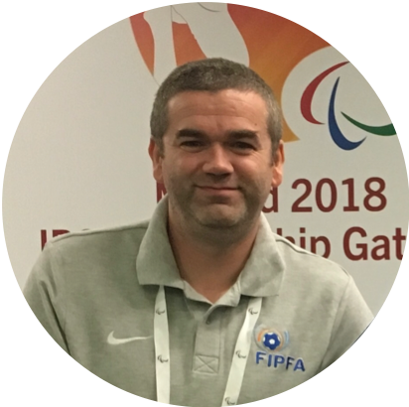
Introduction
Notes:
Introduction and welcome

Slide 10
REPORTS

Slide 11
Zone Reports by Zone Presidents
Zone Reports:
Americas – Pablo del Puerto
Asia-Pacific-Oceania – Tristram Peters
Europe – Donal Byrne

Slide 12
PABLO DEL PUERTO - AMERICAS ZONE

Slide 13
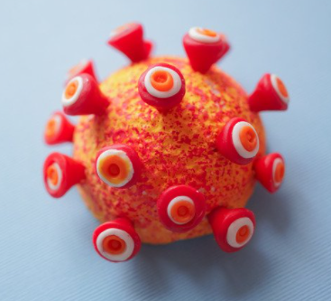
Health situation
Health Situation APFC
Due to the sanitary restrictions of the member countries, we were unable to return to activity in all the countries.
Some countries were able to return
to training.

Slide 14
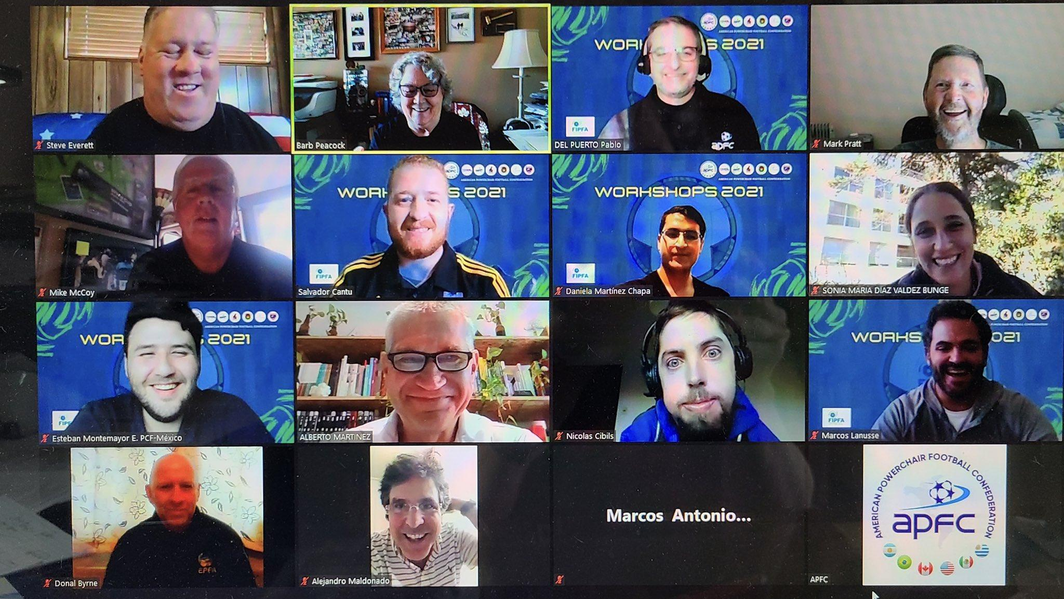
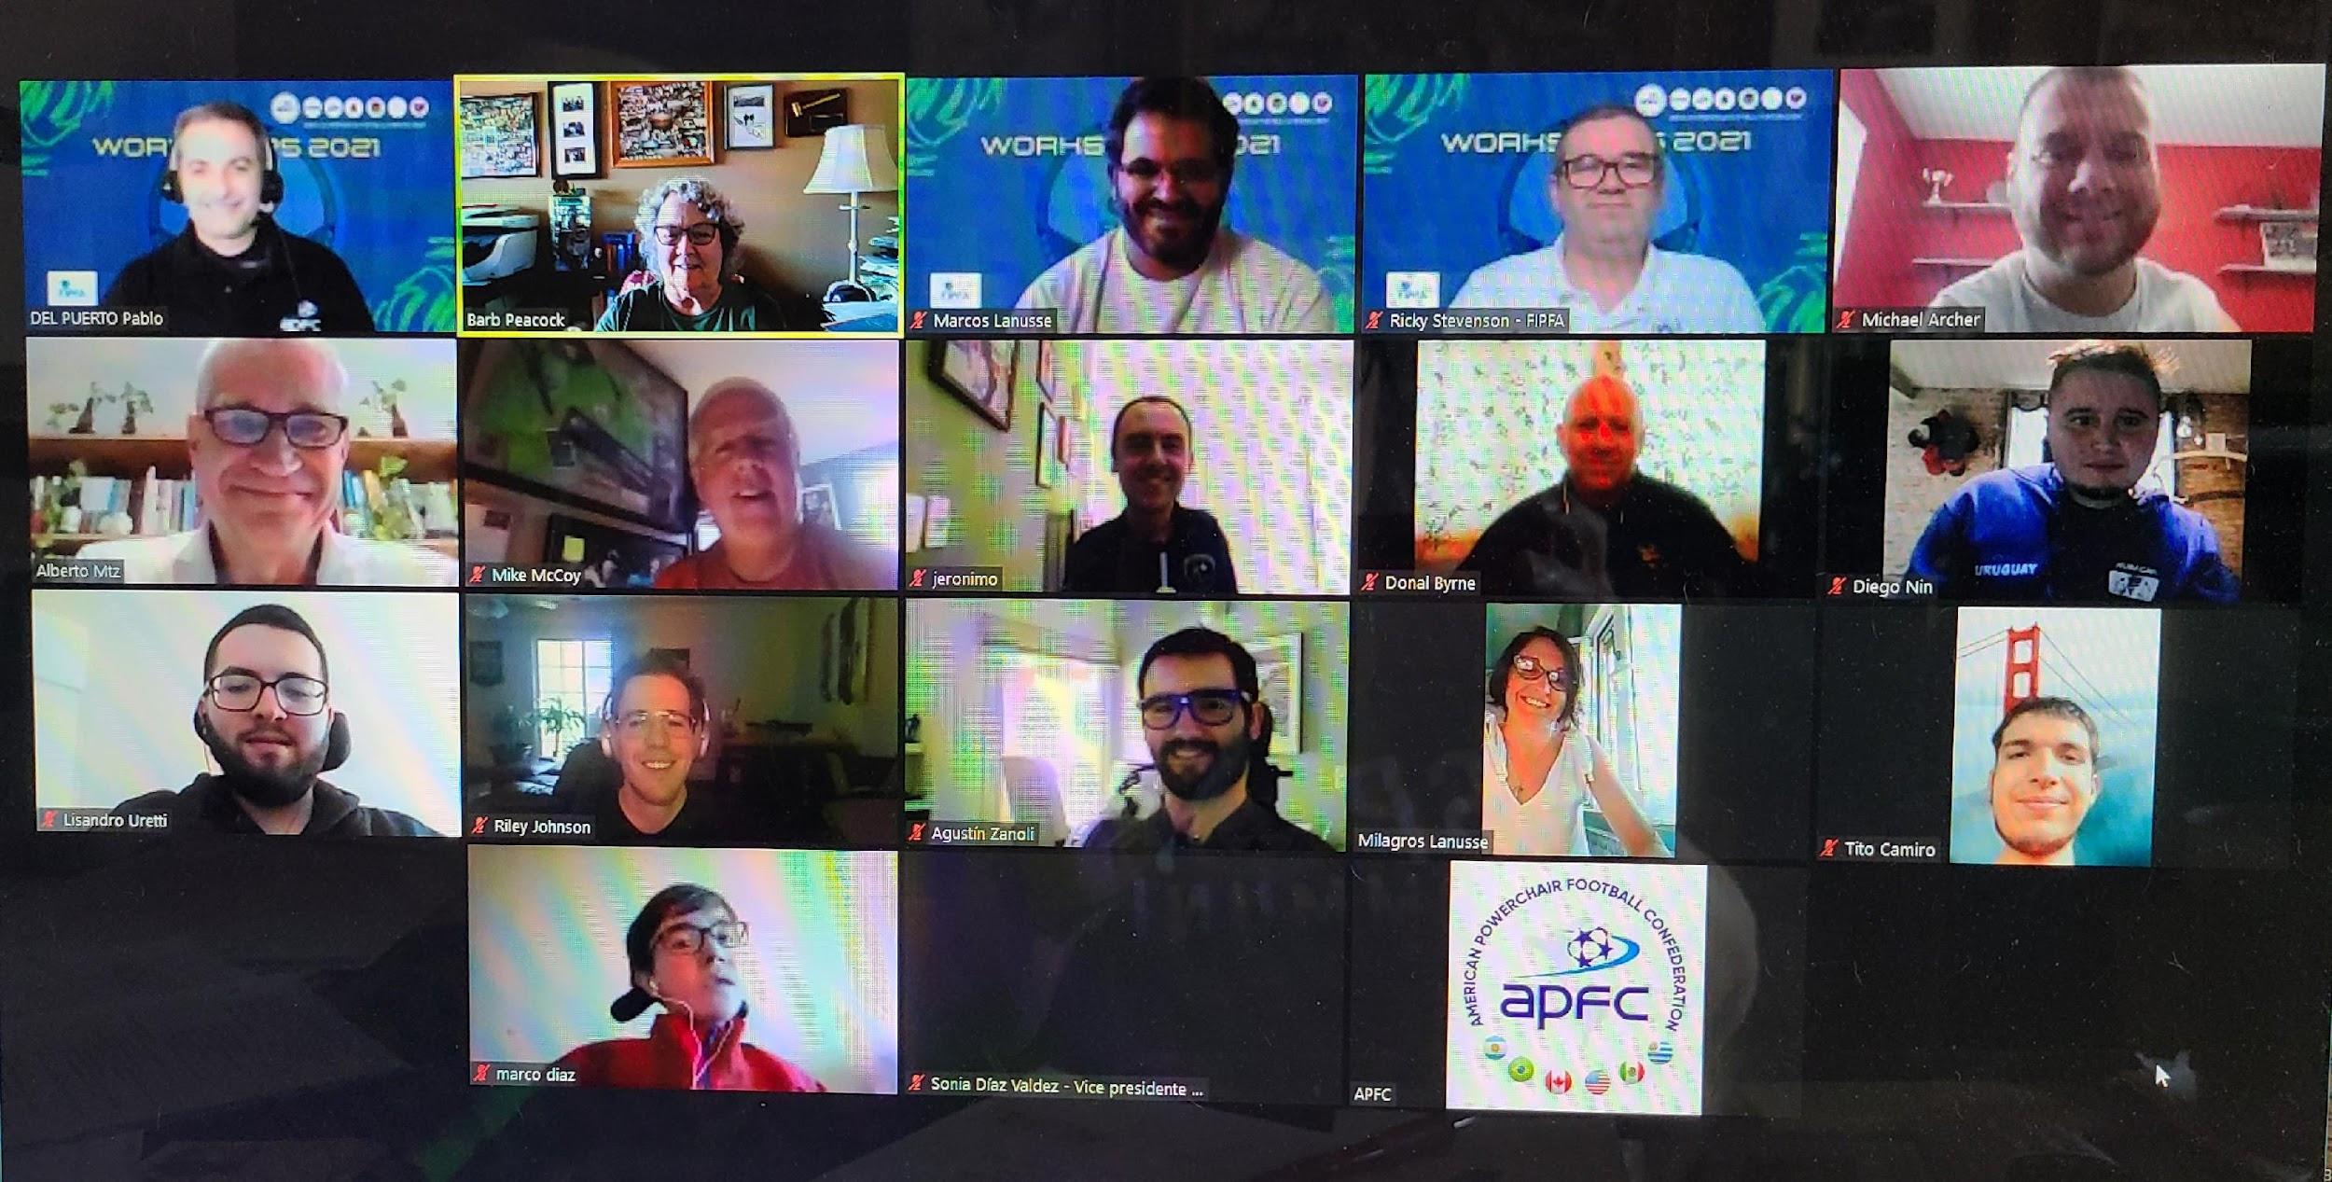
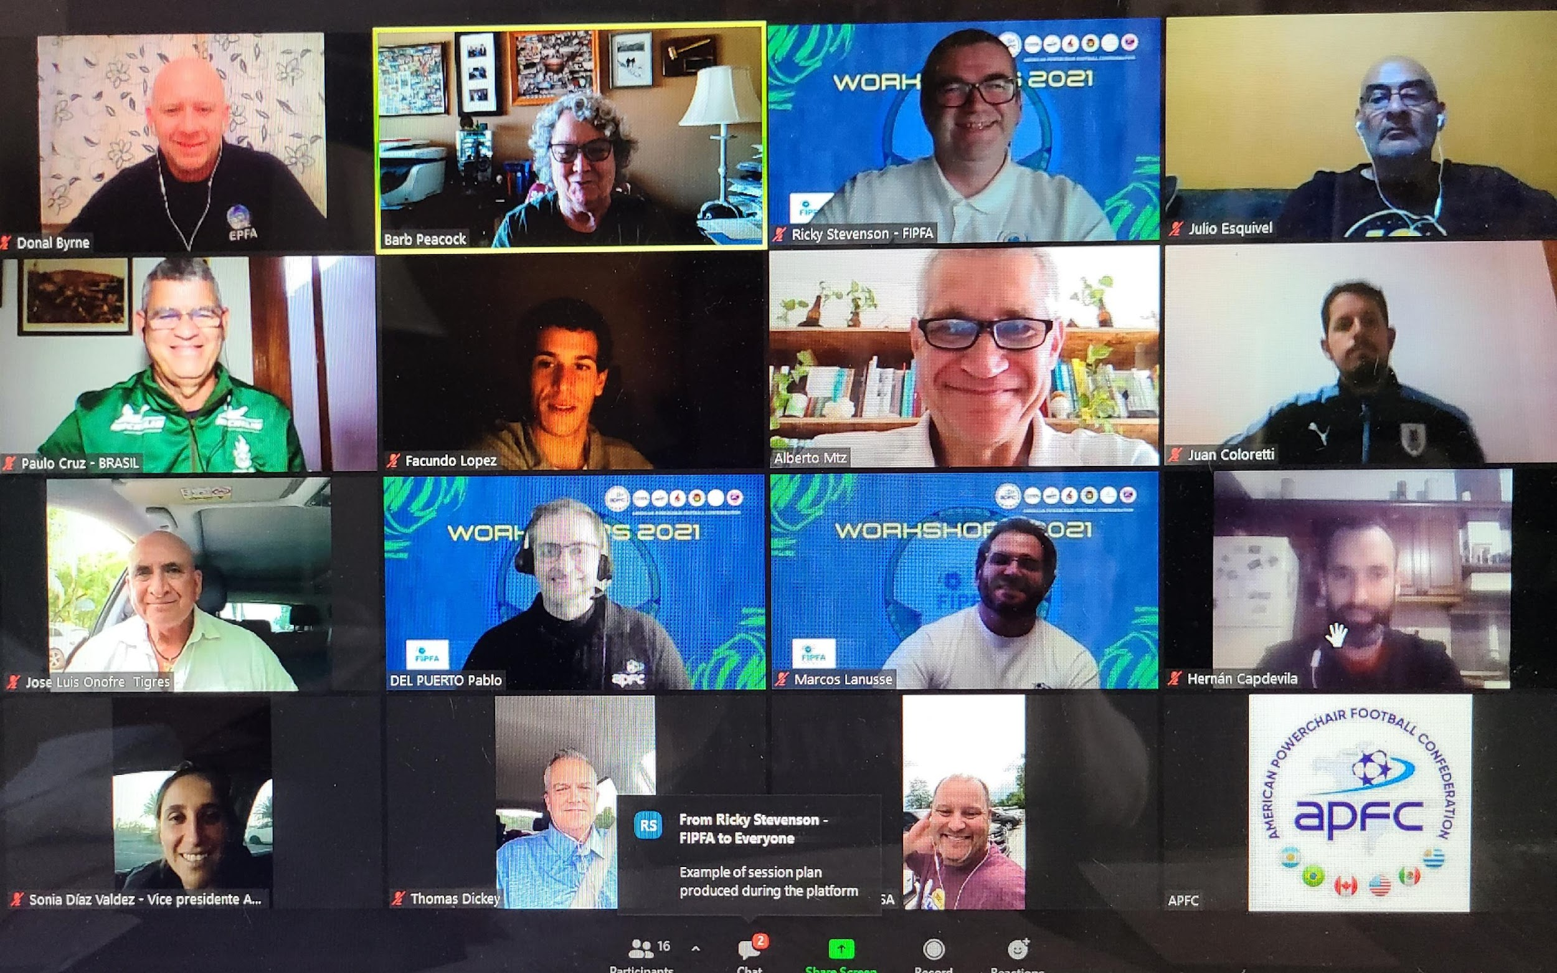
Organization
Workshops APFC – FIPFA Workshops NOPFs
Workshops Players Workshops Coaches

Slide 15
Competitions
The Copa Libertadores (Clubs) and the Copa Sudamericana (National Teams) have been postponed due to the continuity of Covid19 in the zone.

Slide 16
Development & Expansion
New Teams
Argentina Botines de Acero (Cordoba)
México Rayados (Monterrey)
USA The Green Machine (Texas)
Next Countries
Guatemala (in process)
Chile (stand by)

Slide 17
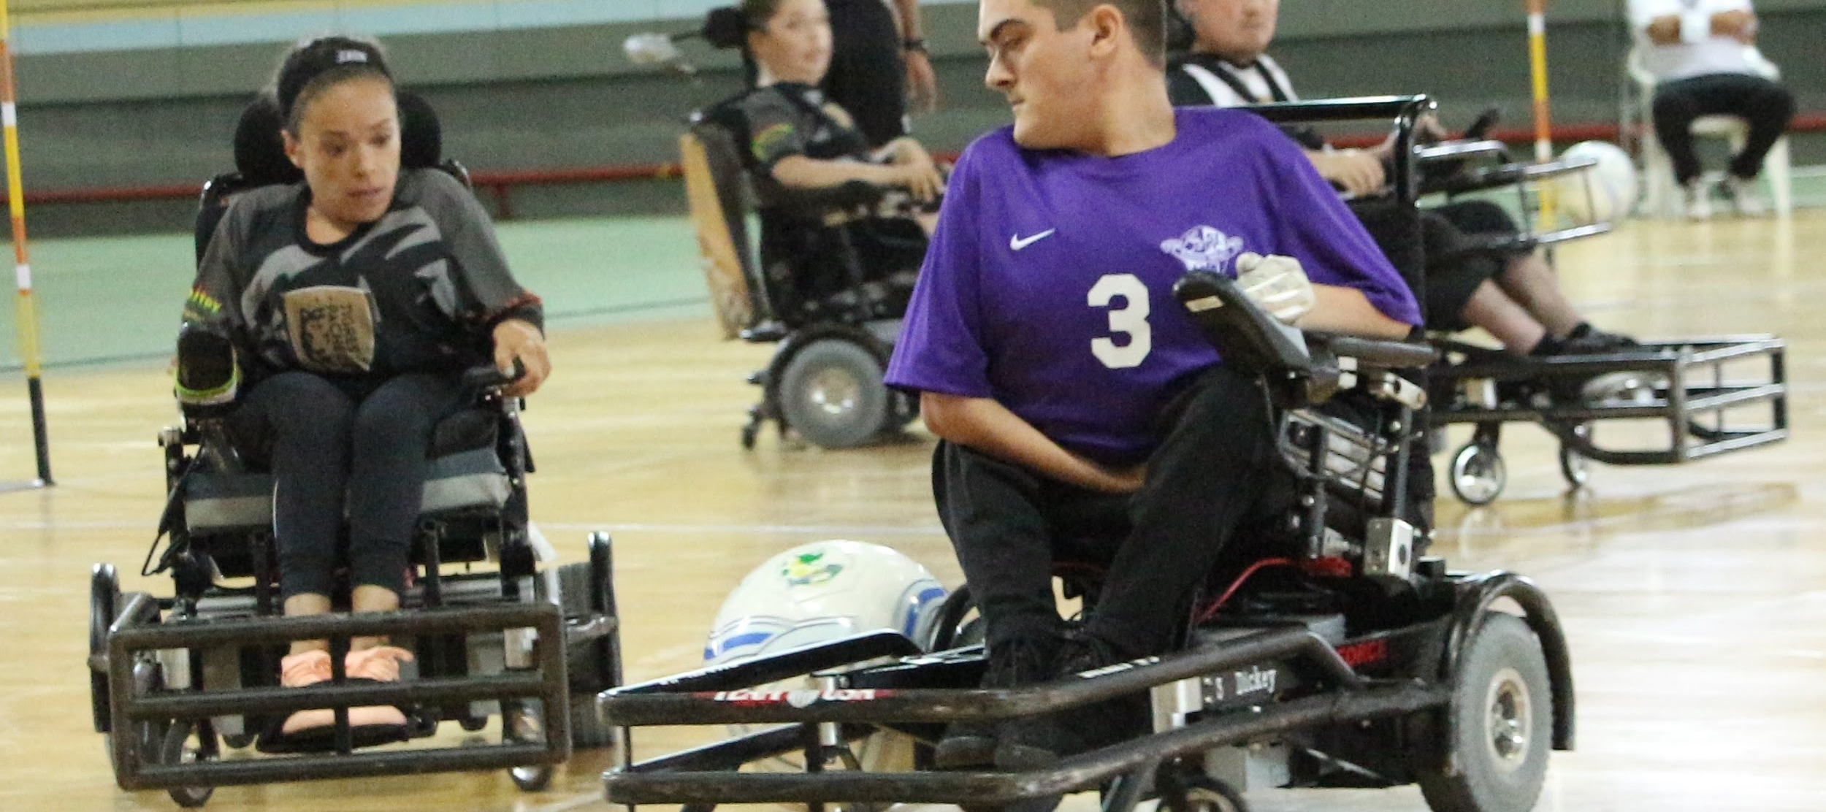
QUESTIONS?
Any Questions?

Slide 18
TRISTRAM PETERS - ASIA PACIFIC OCEANIA ZONE

Slide 19
ASIA PACIFIC OCEANIA ZONE – BRIEF SUMMARY
The APO Zone Congress ExCo:
President: Mr. Shinchiro Obata-san (Japan)
Vice-President: Ms. Cecelia Hutchinson-Parsons (Aus)
Communications: Mr. Jo Yamaki-San (Japan)
Director of Sport: vacant
Treasurer: vacant
General Secretary: Mr. Tristram Peters
Guardians: Mr. Matt Cross (Aus), Mr.Tadanori Yoshino-San (Japan), Ms. Angela Pulini (NZ), Mr. Jingon Kim (Korea)

Slide 20
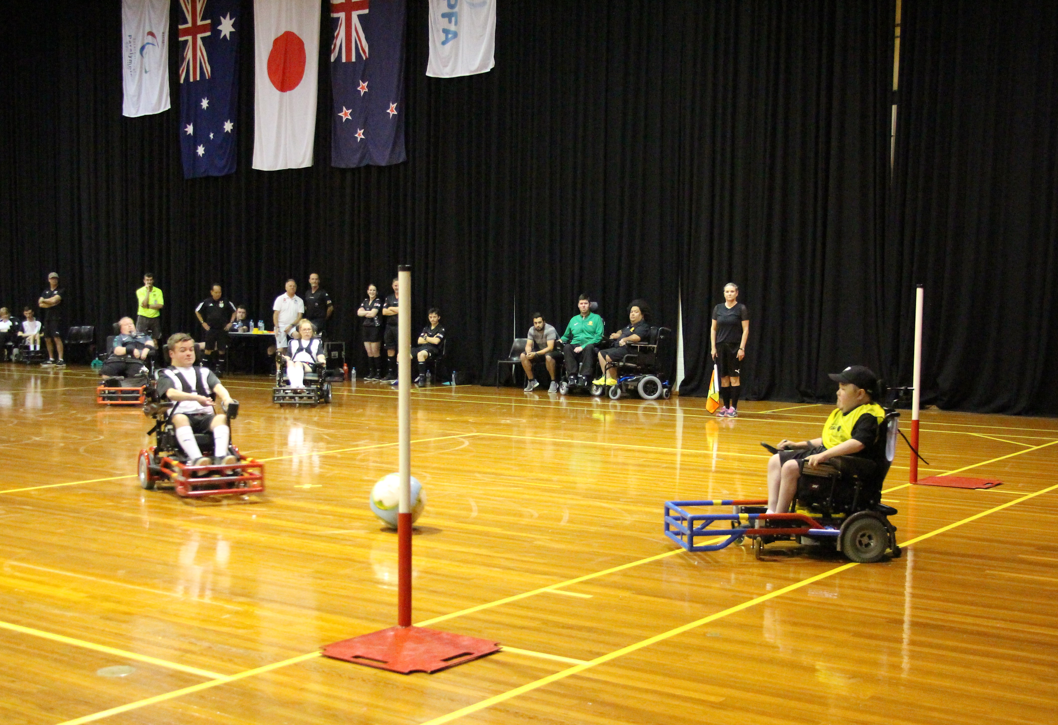
ASIA PACIFIC OCEANIA ZONE: BRIEF SUMMARY
The APO Zone currently has four members for 2021:
Australia
Japan
New Zealand
Korea
Nations developing the sport:
India
Singapore

Slide 21
ASIA PACIFIC OCEANIA ZONE: TRISTRAM PETERS
Updates:
World Cup launch
FIPFA Workshops for NOPFs, Players and Coaches
APO Surveys

Slide 22
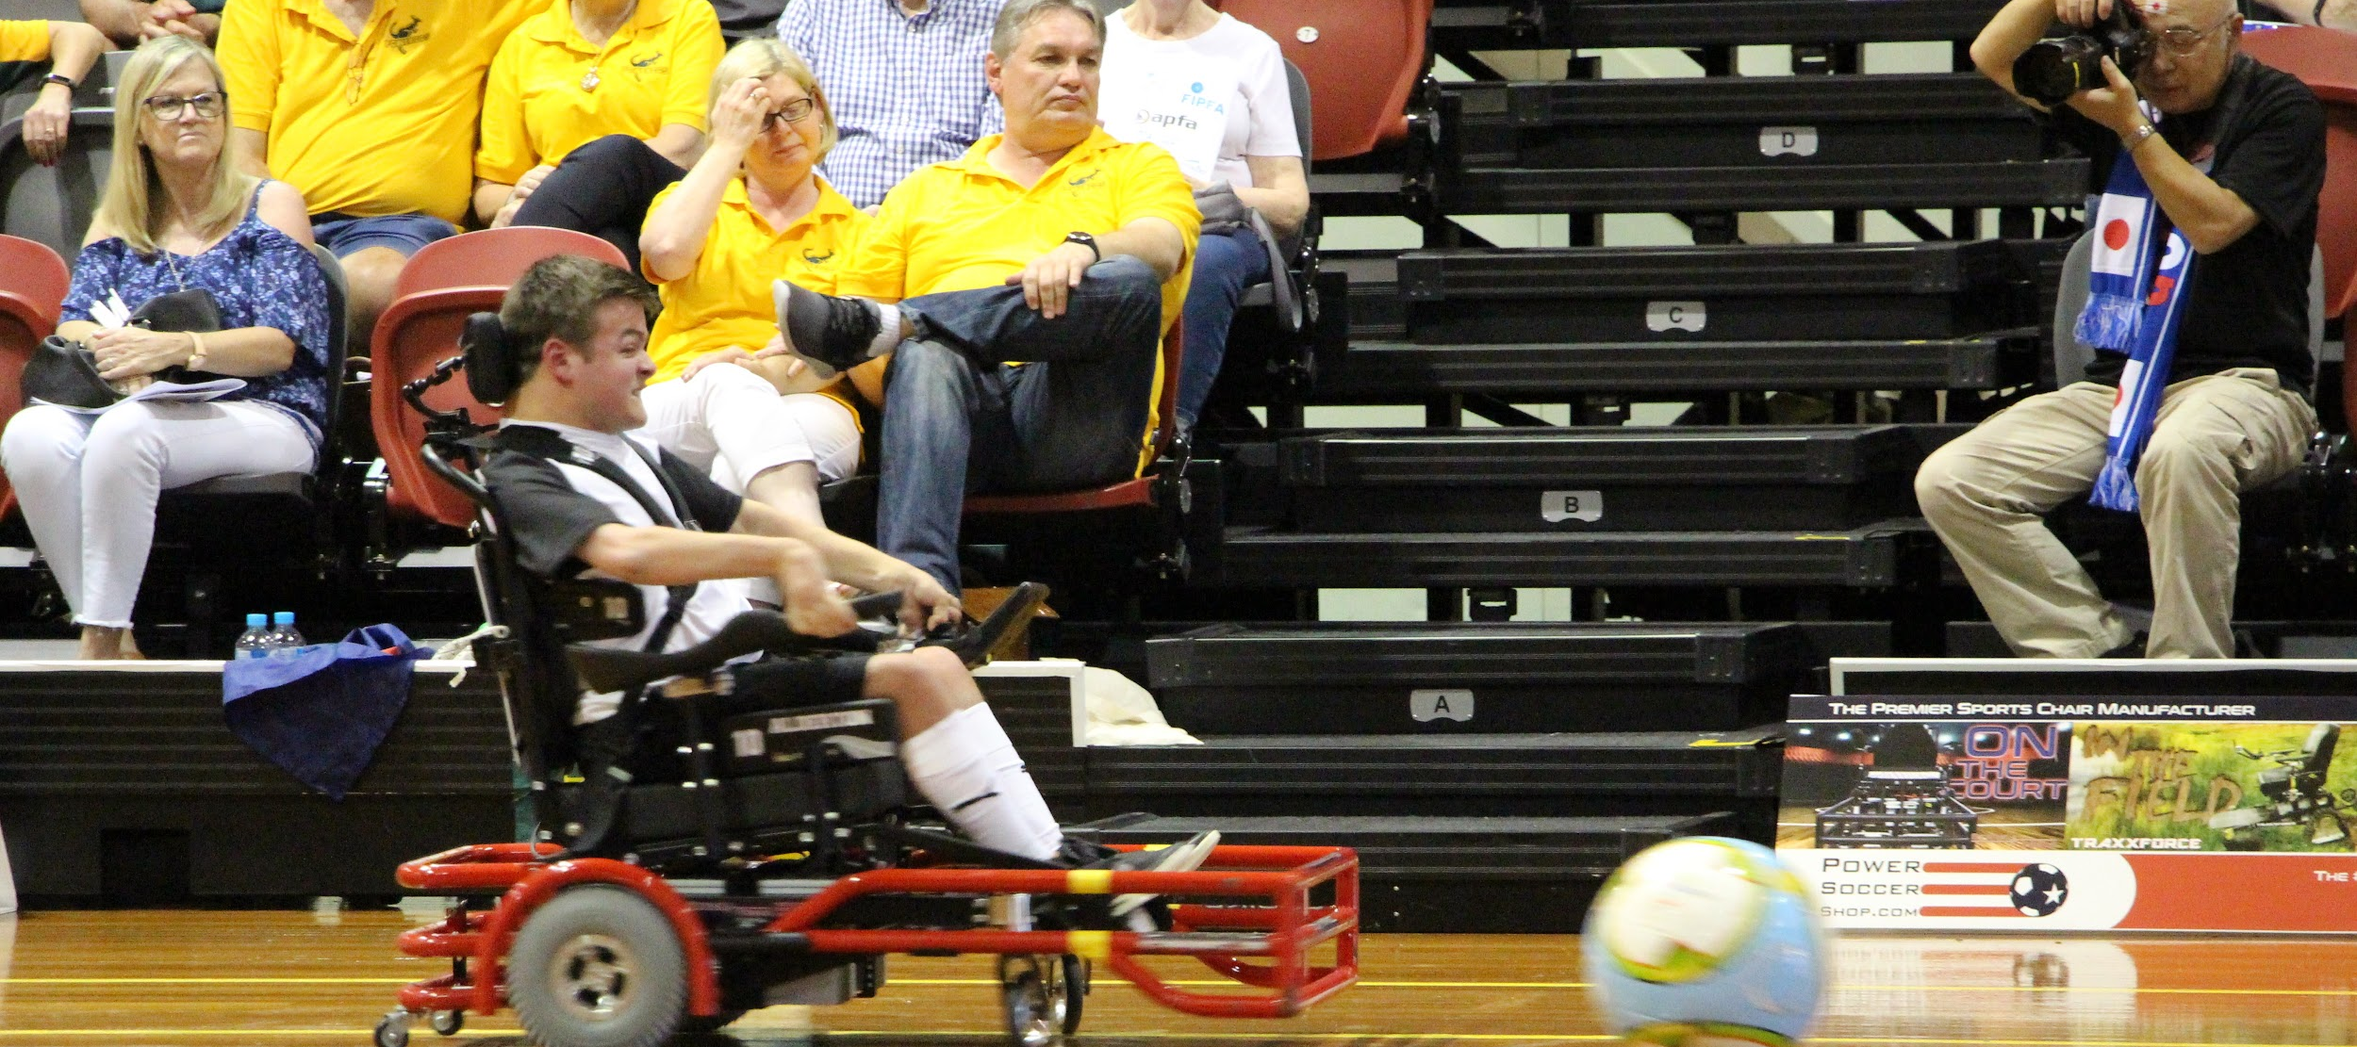
QUESTIONS?
Any Questions?

Slide 23
DONAL BYRNE - EUROPEAN ZONE

Slide 24
Online Engagement and Off-Court Activity
EPFA News
Education Opportunities - Johan Cruyff Institute
Sports Psychology workshops - Erin Prior
In Conversation Series -
Club Twinning & EmPals
Football For All Leadership Programme

Slide 25
Engagement Workshops

Slide 26
Events Cancelled
EPFA Champions Cup August 2021
Next & New Generation Youth Camps
Training Clinics - Referees Classifiers, Coaches

Slide 27
Global Vaccination Programme

Slide 28
Return to On-Court Activity
Return to club training
Friendly club matches
Return to scheduled leagues
Return to national team training

Slide 29
Head and Assistant Head European Referee Appointment

Slide 30
Developing New Members
Welcome to Russia as an associate member
Potential New Members
The Netherlands
Belgium
Portugal
Croatia
Sweden
Wales
Israel

Slide 31
2022 Planning
EPFA CUP - Geneva
New Generation Youth Camp - Spain
Possible Home Nations Development Tournament
Training Clinics - Referees Classifiers Coaches
Off Court Activity - Johan Cruyff Sport Psychology Workshops Football For All Leadership Programme

Slide 32
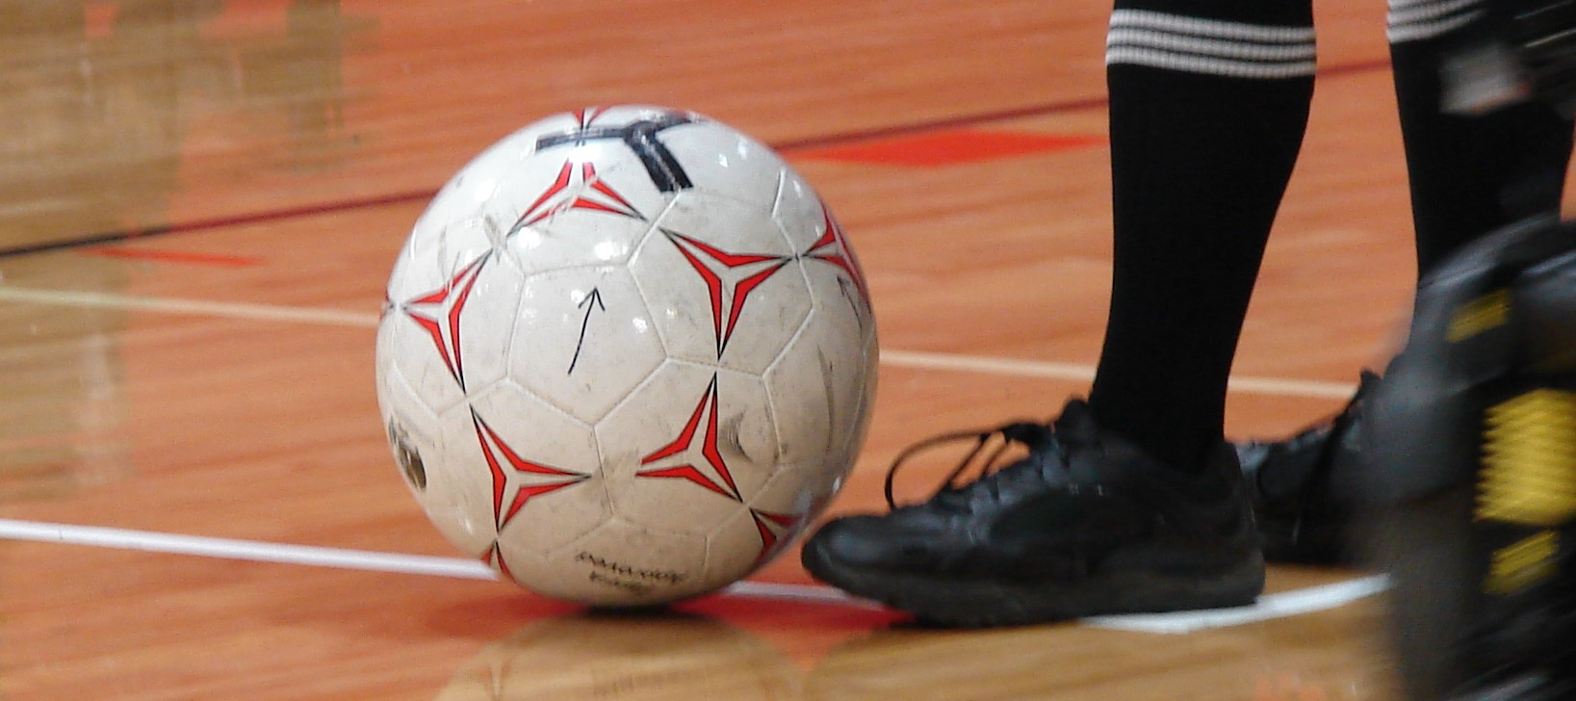
QUESTIONS?
Any Questions?

Slide 33
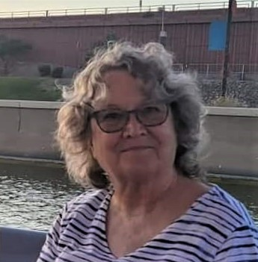
BARB PEACOCK - SECRETARY GENERAL

Slide 34
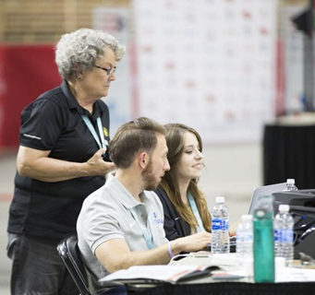
Status of the Secretariat
Duties and Responsibilities:
Manage the day to day business of FIPFA
Maintain communication with Zones and NOPFs
Maintain organisation of information
Field issues and questions from interested parties
Organise Executive Council meetings, take notes, and disseminate minutes to ExCo members
Prepare annual reports
Organise the annual Congress.
Others as assigned by the president

Slide 35
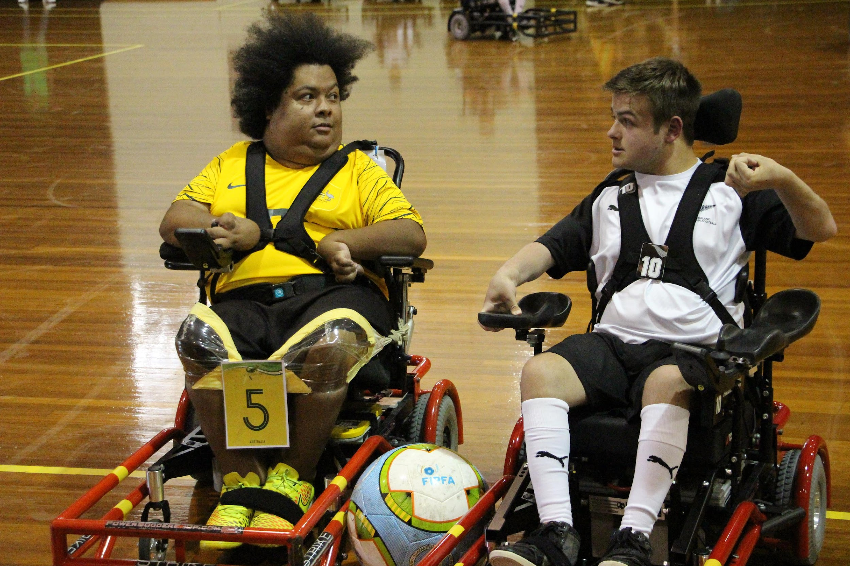
Status of the Secretariat
November 2020 - October 2021:
ExCo meetings
Held monthly meetings with the Executive Council and the lead Zone Representatives
Worked with FIPFA President on content
Prepared and disseminated the agendas
Shared the minutes from each with the ExCo.
Annual Congress
Assisted in the preparation of the virtual Congress
Created Minutes and disseminated to all participants
Prepared the Annual Report

Slide 36
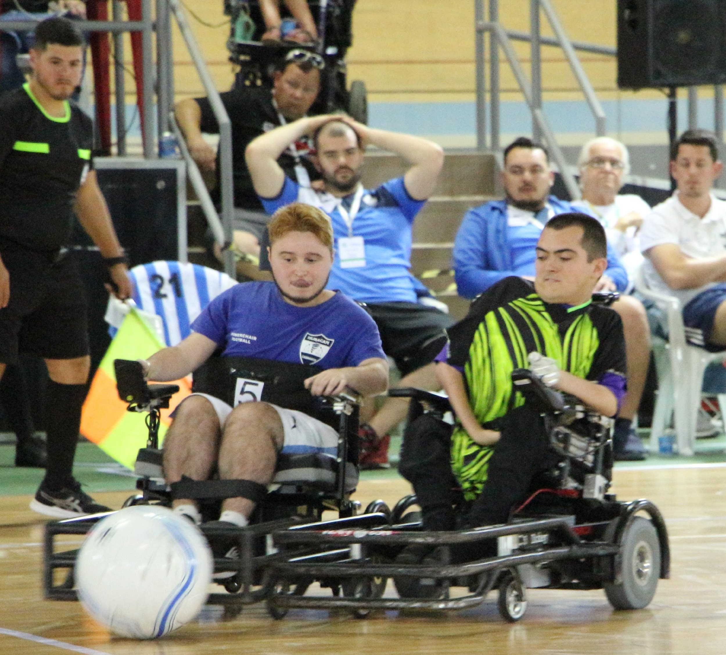
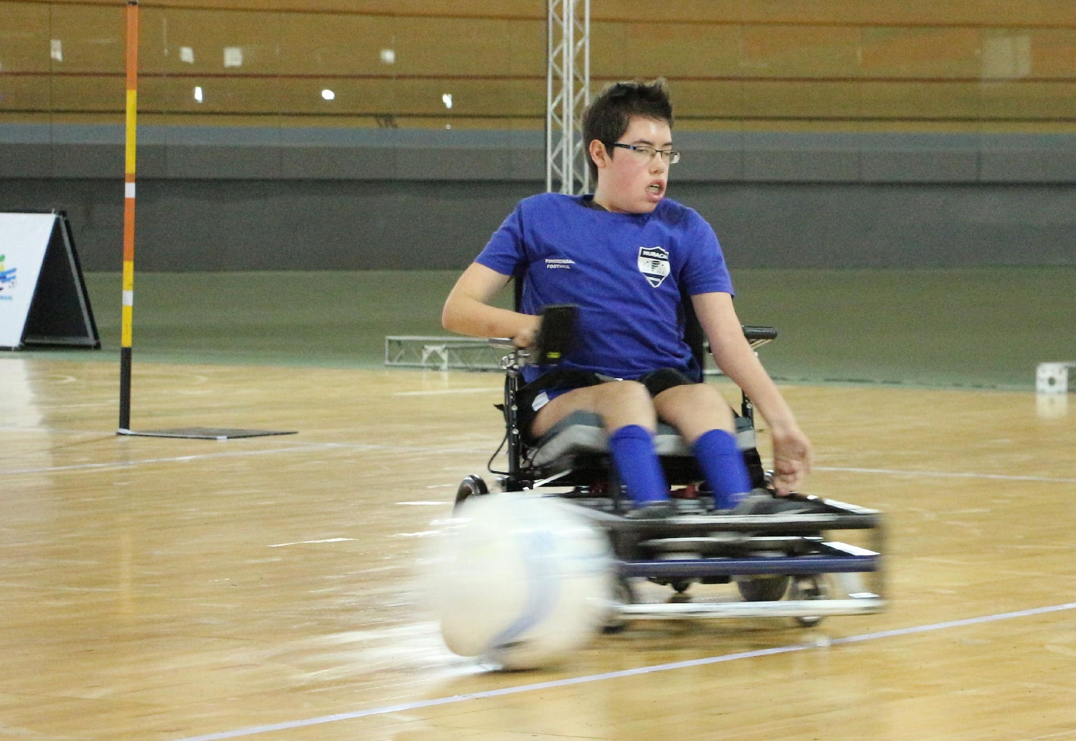
Status of the Secretariat
November 2020 - October 2021:
Communication
Maintained current NOPF contact information
Maintained communication with all NOPFs
Appointed Ryan Sipple as Communications Officer in June.
Michael Jeffress stepped down in May due to family issues
Ryan
Has increased our presence on all social media platforms
Is building our new FIPFA website:
Easier to maintain and update on an English platform
Each NOPF will have a page
User friendly for phones and tablets
Notes:
Ryan to be introduced by Barb

Slide 37
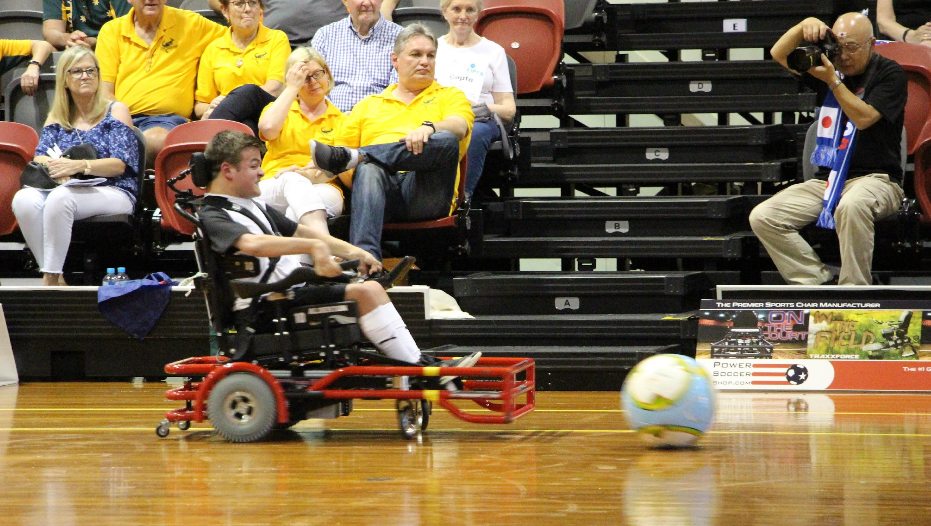
Status of the Secretariat
Goals for 2022:
Find more sponsors
Increase membership
Increase visibility of FIPFA
Continue to improve communication with Zones, NOPFs, and other countries who play the sport.

Slide 38
Status of the Secretariat - PRIORITIES
Priority is Communication –
Important to continue to send updates to us for the website fipfa.org
Articles, new photos, etc.
Please keep your website active and up-to-date and make sure they are linked to fipfa.org
Social media accounts – link with FIPFA’s
Contact secretarygeneral@fipfa.org or communication@fipfa.org for questions and more information.

Slide 39
ELECTION INFORMATION
Voting will be toward the end of this meeting
Only Current Full Affiliated Members will be allowed to vote.
1 vote per delegation
In accordance with the regulations annexed to the FIPFA Constitution, the election of officers of the FIPFA Council is staggered.
In May, the Board (ExCo) unanimously approved altering the election cycle for Treasurer and President:
Hervé had stated he will not stay on until 2022. It does not make sense to appoint a temporary treasurer in May and elect one in 2022.
The role of President has historically been up for election during the Congress at a major event, typically the World Cup. Realignment would continue this tradition and extend Ricky’s term to a 4th year.

Slide 40
ELECTION INFORMATION
Original Alignment:
New Alignment:
 | 2019 | 2020 | 2021 | 2022
President |  |  | ELECTION
Vice President | ELECTION
Treasurer |  |  |  | ELECTION
Director Of Sport |  | ELECTION
 | 2019 | 2020 | 2021 | 2022
President |  |  |  | ELECTION
Vice President | ELECTION
Treasurer |  |  | ELECTION
Director Of Sport |  | ELECTION

Slide 41
ELECTION INFORMATION
Voting will be toward the end of this meeting.
Ballots were emailed to the designated voter at the start of this meeting.
Only Current Full Affiliated Members will be allowed to vote.
1 vote per delegation
Your ballot will consist of 2 items:
Selection of Treasurer
Approval of the proposed Constitution
Votes will be tallied automatically and reported by Ricky at the conclusion of the meeting.

Slide 42
BARB PEACOCK - SECRETARY GENERAL
ANNUAL
REPORT

Slide 43
2020 Membership:
In 2020 FIPFA had 21 Member Nations:
AMERICAS | EUROPE |  | ASIA/OCEANIA
 | FULL AFFILIATE MEMBERS
Argentina | Austria | Northern Ireland | Australia
Brasil | Denmark | Republic of Ireland | Japan
Canada | England | Scotland | New Zealand
United States | Finland | Spain
Uruguay | France | Switzerland
 | Germany
 | ASSOCIATE MEMBERS
Mexico | Italy

Slide 44
Statistics from 2020:
In 2020 FIPFA had 21 Member Nations:
 | 2020 | 2019 | difference | %age Growth
Registered Clubs | 227 | 232 | -5 | -2.16%
Registered Teams | 385 | 374 | 11 | 2.94%
 | 2020 | 2019 | difference | %age Growth
Referees | 360 | 308 | 52 | 16.88%
Classifiers | 49 | 41 | 8 | 19.51%
Coaches | 324 | 284 | 40 | 14.08%

Slide 45
Statistics from 2020:

Slide 46
FINANCIAL REPORT
Treasurer’s report for 2020:
Bank Accounts Balance 31/12/19 | 3,512.35 €
2020 INCOME | 32,661.56 €
2020 EXPENSES | 7,577.41 €
2020 BALANCE | 25,084.15 €
Bank Accounts Balance 31/12/20 | 28,596.50 €

Slide 47
2020 INCOME
Income
2020 Membership Fees | 9,401.85
Overpayment | 188.67 €
PSS Partnership | 14,990.00 €
Technical Fees for WC 2022 | 7,808.65 €
PayPal balance 12/30/2019 | 34.89 €
Total Income | 32,424.06 €

Slide 48
2020 EXPENSES
Expenditures by Department
Sports Department | 7,184.61 €
Secretariat, Administration, and Communications | 392.80 €
Total | 7,577.41 €
See next slide for detail

Slide 49
2020 EXPENSES
Expenditures by Department
Secretariat, Administration, and Communications: |  | Department of Sport:
Officials APFC and APO Cups |  | 6587.11€
Classification Database |  | 360.00 €
PayPal Fees |  | 237.50 €
Bank Fees | 208.00 €
Website Hosting/Domain names | 184.80 €
Total Expenditures for 2020 | 7,577.41

Slide 50
FINANCIAL REPORT
Monies still owed as of 31 December 2020:
APO Cup VISA Fees | 188.00 €
Evidence-based Classification Research | 640.00 €
Total Outstanding debts due 31/12/2020 | 828.00 €

Slide 51
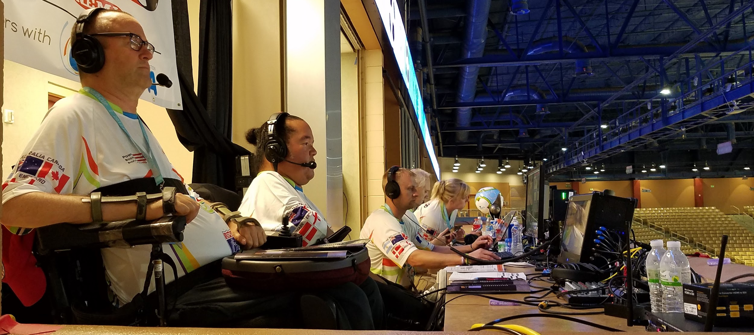
QUESTIONS?
Any Questions?

Slide 52
THANKS!
Any questions?
Please email me at secretarygeneral@fipfa.org

Slide 53
Reflections 20/21
2020 Reflections
(November 2020 – October 2021)

Slide 54
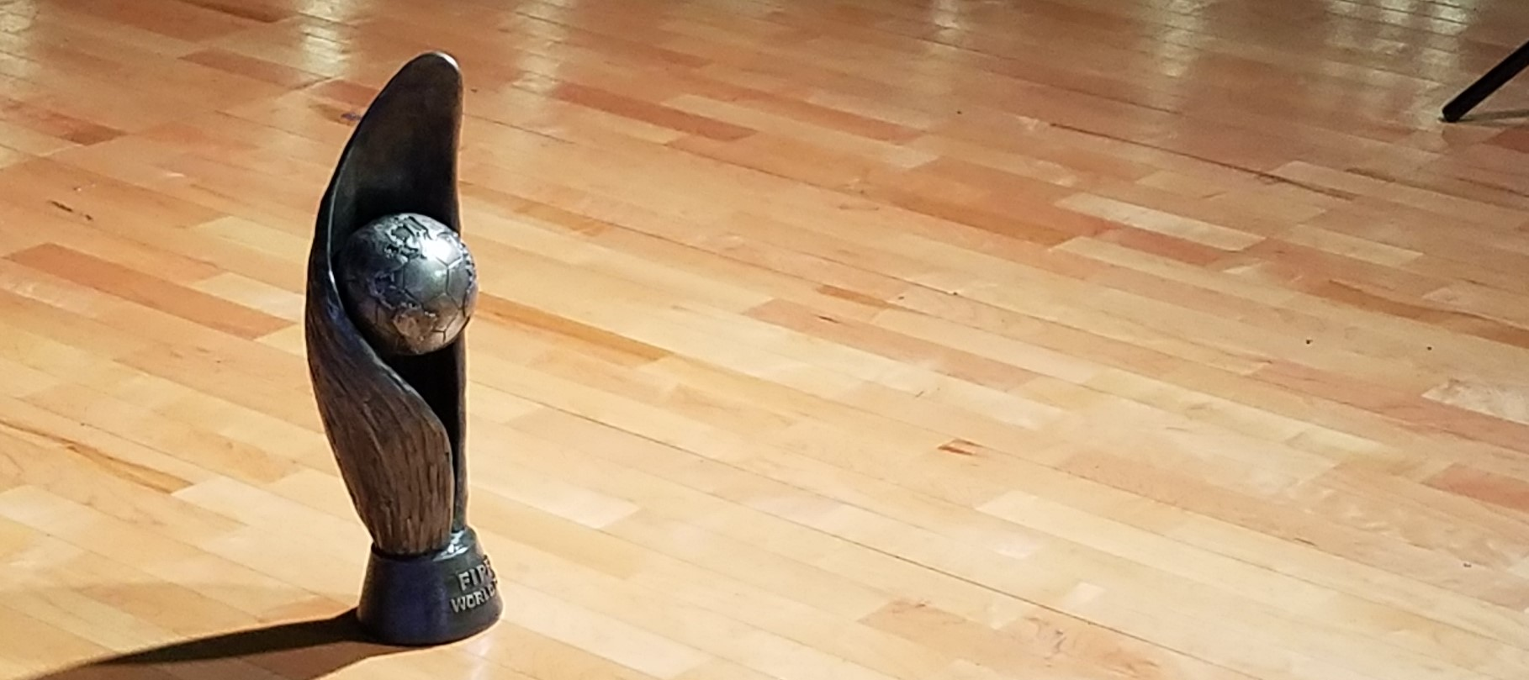
QUESTIONS?
Any Questions?

Slide 55
PARTNER UPDATES
2021: Continued partnership with Powersoccer Shop a division of NEMI as our Elite Partner
2021: Continued partnership with YOOLA as our Travel Partner
2021: Continued membership as International Federation of IPC
Recognized International Federation

Slide 56
PARTNER UPDATES
December 2020: Became founding members of Para Football (body of football for persons with disabilities).
2021: Formed partnership with Goals Beyond Grass to support technology- database and website
2021: Formed partnership with ASC Cloud (Sports Session Planning Platform).
2021: Formed partnership with SNAP Sponsorship (Online Sponsorship Platform).

Slide 57
QUESTIONS?
Any Questions?

Slide 58
FIPFA Powerchair Football World Cup 2022

Slide 59
2022 Powerchair Football World Cup Update
Confirmation of Nations Qualified
Hosts
Australia
EPFA Qualified Nations
England France Ireland Denmark Northern Ireland
APFC Qualified Nations
USA Uruguay Argentina
APO Qualified Nations
Japan

Slide 60
2022 Powerchair Football World Cup Update
Andy Harper – Chair of the Local Organising Committee

Slide 61
QUESTIONS?
Any Questions?

Slide 62
Sport Department Updates
Sophie Bevan

Slide 63
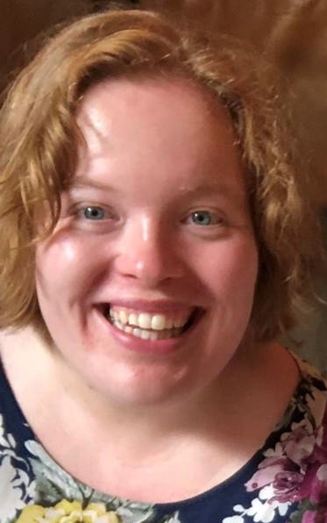
SOPHIE BEVAN- DIRECTOR OF SPORT

Slide 64
Sport Department Update
Technical Update
Milton Tuttle stepped down from the position of Technical Officer in May 2021
We are still looking for someone with the correct knowledge to fill this position
Towards the end of 2021 into early 2022 we will look to form a technical committee who work together on the many different technical aspects of our sport. If you are interested in being a part of this committee please email sport@fipfa.org
APPOINTED OFFICER
APPOINTED OFFICER
VACANT
Florent Bokobza (FRA)

Slide 65
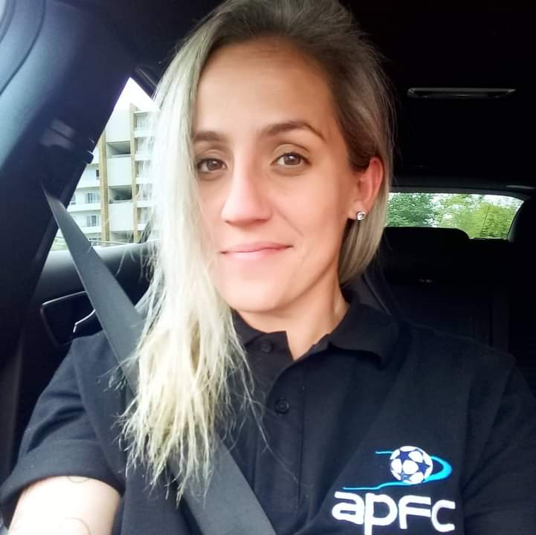
Sport Department Update
Competitions Update
APPOINTED OFFICER
Appointed by Sports Dept. in January 2020
Due to Covid-19 pandemic, events for 2020 and 2021 have been postponed/cancelled so Hanna will be assisting with planning and execution of events in 2022/2023
APPOINTED OFFICER
Hanna Kwitko (BRA)
Nicolas Dubes (FRA)

Slide 66
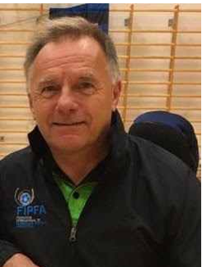
Sport Department Update
Referees Update
As with other departments, 2020/2021 was a non-event for FIPFA referees. It was planned and is still hoped to have a visit to Sydney to finally sign off two referees to enable there to be home referees at the October 22 World Cup, finger crossed for this to happen in April 2022.
APPOINTED OFFICER
APPOINTED OFFICER
Martin Bevan
(ENG)
Florent Bokobza (FRA)

Slide 67
Sport Department Update
Referees Update continued
Continue to support the Zone Referee Heads and it would be good if we were able to have these together before the World Cup so that a unified strategy can be formed for refereeing world wide going forward.
It is good to see National Leagues starting up and I know that some zones are starting new referee training as no doubt we will have lost some over the prolonged break.
APPOINTED OFFICER
APPOINTED OFFICER
Martin Bevan
(ENG)
Florent Bokobza (FRA)

Slide 68
Sport Department Update
Referees Update
APPOINTED OFFICER
APPOINTED OFFICER
Any Questions?
Martin Bevan
(ENG)
Florent Bokobza (FRA)

Slide 69
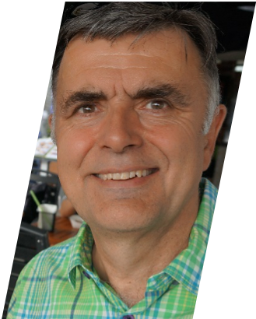
Sport Department Update
APPOINTED OFFICER
Classification Update
Stewart Evans
(ENG)

Slide 70
Sport Department Update
Classification Update
We have developed a new classification database alongside Goals Beyond Grass
The new database has been tested at one national league event in England, with further tests planned before Christmas
As part of developing the new classification database, NOPF’s can have to their own National Classification Database- €466 (£400) per country per year
Accurate classification status is vital for all players and their NOPF’s
Positive discussions to deliver classification courses in both Italy and Spain
APPOINTED OFFICER
Stewart Evans
(ENG)

Slide 71
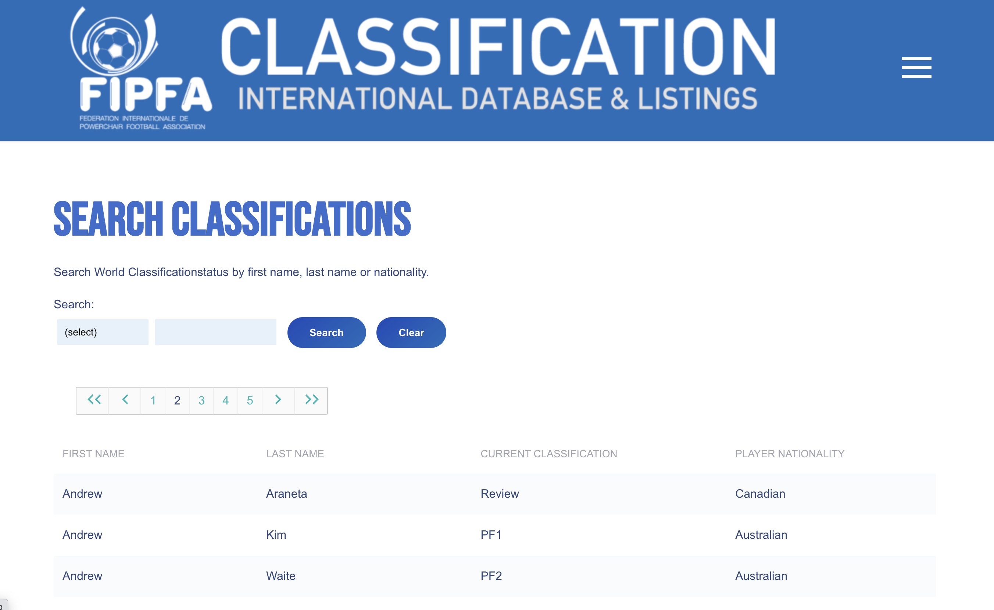
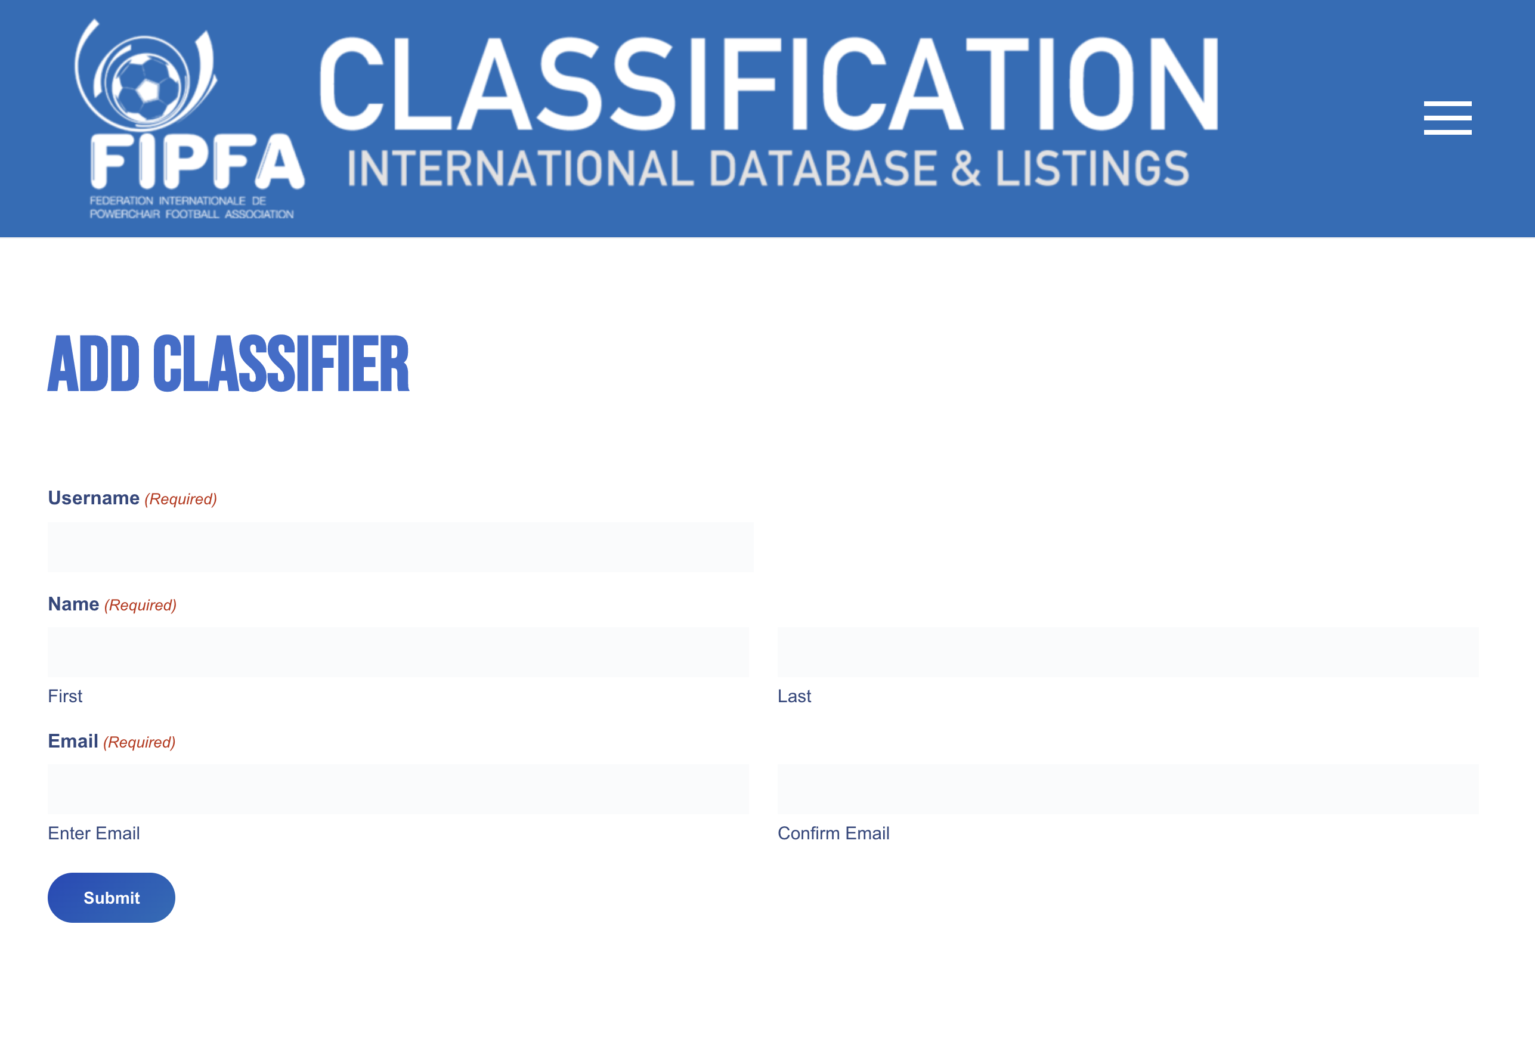
Sport Department Update
Classification Update
Stewart Evans
(ENG)

Slide 72
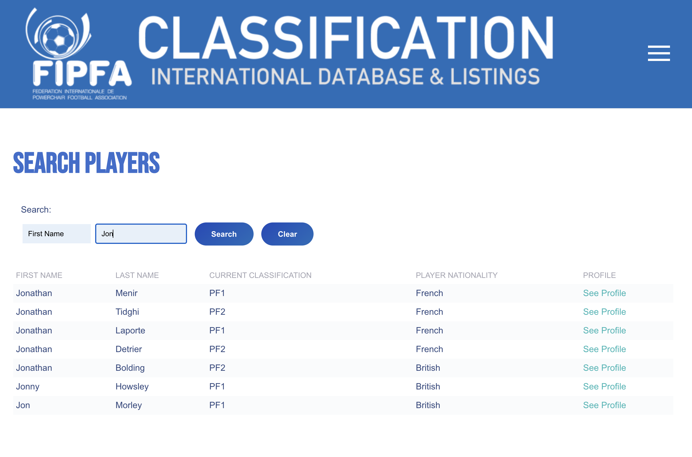
Sport Department Update
Classification Update
Stewart Evans
(ENG)

Slide 73
Sport Department Update
Classification Update
APPOINTED OFFICER
Any Questions?
Stewart Evans
(ENG)

Slide 74
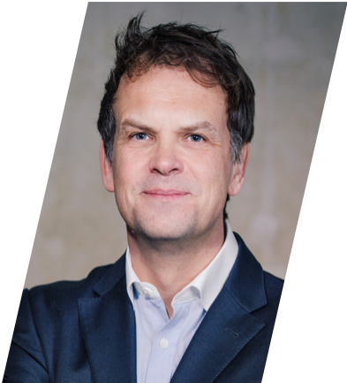
Sport Department Update
Anti-Doping Update
Anti-doping plans focus on the World Cup 2022.
A brief to qualifying nations will be sent in January 2022 containing an information package and a communications plan. The key contacts for the qualifying nations will be an important part of this plan.
APPOINTED OFFICER
Graham Arthur
ENG

Slide 75
Sport Department Update
Anti-Doping Update
The information package will provide qualifying nations with key advice concerning core matters including the use of medications by players; supplement and nutrition risk awareness; and the Doping Control process.
APPOINTED OFFICER
Graham Arthur
ENG

Slide 76
Sport Department Update
Anti-Doping Update
The communication plan will encompass key material concerning the introduction of the Doping Control process in 2022. This will include information, practice and guidance regarding the process for obtaining exemptions for the use of medications.
APPOINTED OFFICER
Graham Arthur
ENG

Slide 77
Sport Department Update
Anti-Doping Update
APPOINTED OFFICER
Any Questions?
Graham Arthur
ENG

Slide 78
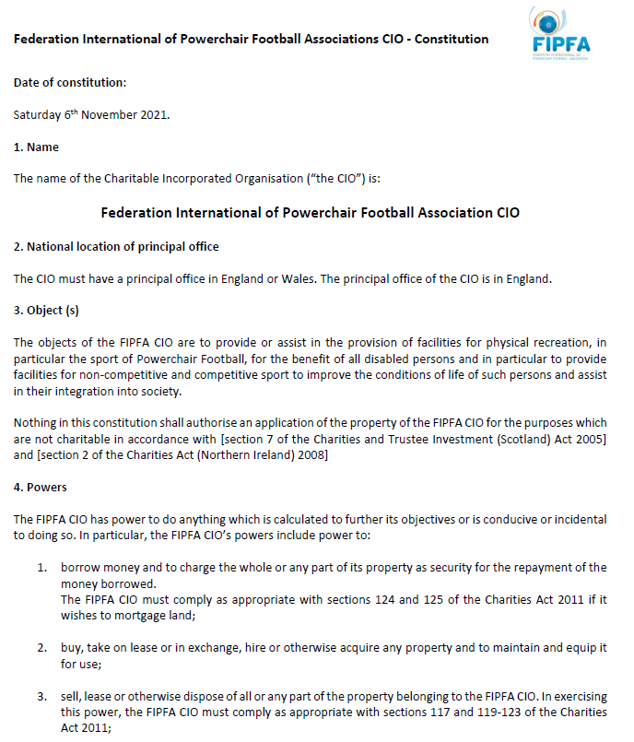
Constitution Update:

Slide 79
Constitution Update:

Slide 80
QUESTIONS?
Any Questions?

Slide 81
ELECTIONS 2021

Slide 82
ELECTION INFORMATION
Only Current Full Affiliated Members will be allowed to vote.
1 vote per delegation
In accordance with the regulations annexed to the FIPFA Constitution, the election of officers of the FIPFA Council is staggered:
 | 2019 | 2020 | 2021 | 2022
President |  |  |  | ELECTION
Vice President | ELECTION
Treasurer |  |  | ELECTION
Director Of Sport |  | ELECTION

Slide 83
VOTING PROCEDURES
An email with ballot and instructions has been sent to the representative who has been given the right to vote by their NOPF.
There is one candidate for the treasurer position
John Moore’s bio was distributed with the agenda on 17 September.
Questions to the candidate?
Please also vote to approve (or not) to allow FIPFA to change the constitution?
Questions?

Slide 84
VOTING PROCEDURES
Please vote now.

Slide 85
CONCLUSION

